Slide 1
The Education of Students with Special Needs
  Human Growth and Development

Slide 3
Who qualifies as a child with special needs?
Notes:
Special needs are the individual requirements (in education) of a child from a disadvantaged background or a child with a mental, emotional or physical disability or one who is at a high risk of developing one. Understanding these needs helps in caring for these children. A variety of professionals can help these children with special needs. Educators should know the district’s policy for referring children to special services. Educators must also know how to create a positive environment for children with special needs in their care.

Slide 4

Understanding Special Needs
  Heredity and environment influence the special needs in individuals.
    Hereditary factors include the genetic history and make-up of a person.
    Environmental factors affect the fetus after conception or the child after birth.
Notes:
Heredity and environment influence the special needs in individuals. Hereditary factors include the genetic history and make-up of a person. Environmental factors affect the fetus after conception or the child after birth.
Many environmental factors can create special needs in children. These factors may include:
Accidents
Alcohol
Child abuse
Drugs
Illness
Poor nutrition
How can an illness create a special need? For example, repeated middle ear infections, if untreated, can cause hearing loss. Such hearing loss can result in delayed language development. Poor nutrition, especially a lack of protein, can cause permanent brain damage. Accidents with cars, poisonous substances and unsafe surroundings often cause disabilities in children. Child abuse can lead to physical and emotional disabilities.
Often the exact cause of a child’s disability is unknown. Experts are learning more about the development of children with special needs. Some disabilities can provide helpful information to parents and others about the prevention of disabling conditions in children.

Slide 5
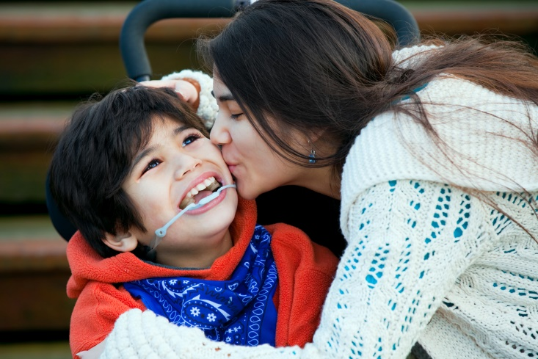
The Nature of Special Needs
  A disability is any condition that prevents, delays or interferes with a child’s normal achievement and development. A disability may be classified as one of the following:
    Developmental
    Learning
    Physical
    Sensory
Notes:
A disability is any condition that prevents, delays or interferes with a child’s normal achievement and development. Developmental disabilities impair a child’s cognitive functioning. Learning disabilities result in reasoning and perceptual problems. Physical disabilities include deformities and diseases of the spine, bone, muscles and joints, as well as other health problems. Sensory disabilities include hearing and vision problems. There are other disabilities which may be related to speech and language disorders. Additionally, there can be behavioral problems which impact social and emotional adjustments.
Another category of special needs is often referred to as “gifted and talented”. Giftedness refers to children with a greater than average ability to learn, reason and create.
Other disabilities may be related to speech and language disorders. Behavioral problems include social and emotional adjustments. Giftedness refers to children with a greater than average ability to learn, reason and create. Often this category is called “gifted and talented.” Children with special needs are classified on the basis of the area of greater need. Each child has unique needs, so these categories can only be used to describe the child in general terms.

Slide 6

Developmental Disabilities
  Some goals for the care and education of children with developmental disabilities are as follows:
    Expanding language skills
    Increasing attention span
    Learning self-help skills
    Mastering basic concepts
Notes:
Developmental disabilities involve cognitive functions which are much lower than average. Poor cognitive development usually prevents a person from functioning well in everyday life. Such deficiencies are obvious during a child’s life.
Developmental disabilities are some of the most common causes of special needs in children. In the past, children with developmental disabilities were referred to as children with mental retardation. Today the disability is called intellectual disability (ID). Children identified with developmental disabilities are grouped into four categories: mild, moderate, severe and profound. Child care programs are most likely to include children with mild or moderate developmental disabilities, rather than children with severe or profound disabilities. These children may be slower than average in some areas of their development. They learn to use the toilet, feed themselves or talk several months later than most children their age. In the classroom, the child with a developmental disability generally needs more time and more repetition to learn new tasks. Tasks should be broken down and presented in a step-by-step manner. Some goals for the care and education of children with developmental disabilities are as follows:
Expanding language skills
Increasing attention span
Learning self-help skills
Mastering basic concepts

Slide 7

Learning Disabilities
  A learning disability involves a disorder in understanding or using spoken or written language.
  A child with a learning disability may be unable to listen, think, speak, spell or do mathematical problems.
Notes:
A learning disability involves a disorder in understanding or using spoken or written language. A child with a learning disability may be unable to listen, think, speak, spell or do mathematical problems.
Learning disabilities are most obvious in the academic classroom settings. Therefore, children with learning disabilities may not be diagnosed until the elementary school years. Traits of learning disabilities in young children may include hyperactivity, impulsiveness, perception (recognition) problems or poor memory. Each of these characteristics in some way makes learning difficult for children with learning disabilities.
There are many theories about what causes learning disabilities. Causes may range from genetic defects to diet. Knowing the exact nature of each child’s needs helps in caring for children.
Why are learning disabilities frequently not diagnosed until a child is in school?
What symptoms of learning disabilities can caregivers look for in preschool children?

Slide 8

Strategies for Working with Disabled Children
  The following strategies are suggestions for working with learning-disabled children:
    behavior modification
    multi-sensory training
    task analysis
Notes:
The following strategies are suggestions for working with learning-disabled children:
behavior modification
multi-sensory training
task analysis
Task analysis involves breaking down a job into small steps. For example, teaching a child how to brush his or her teeth may be broken down into holding a tube of toothpaste, unscrewing the cap, putting toothpaste on the brush, and each of the other small steps involved in the process.
Multi-sensory training helps children learn through use of several senses at one time. An example might be guiding children outdoors to watch, listen, look and hunt for various items which are described by the caregiver.
Behavior modification is a method of changing a person’s behavior through carefully planned consequences for specific behaviors. For example, behavior modification is often used to teach self-help skills such as learning to use the restroom or cleaning up after oneself. For each appropriate behavior the child exhibits, the caregiver responds with praise, a reward or some type of positive reinforcement.

Slide 9

Physical Disabilities
  Educators who care for children with physical disabilities need to learn about each child’s special needs.
Notes:
Educators who care for children with physical disabilities need to learn about each child’s special needs. Some of the following guidelines may apply:
Arrange the environment to allow freedom of movement for the child. Remove the physical barriers.
Check the child’s equipment frequently to be sure it is working and fitting properly.
Help the child learn self-help skills.
Encourage the child to be actively involved with the group.
Know first aid procedures for the child with epilepsy or other chronic health problems.
Know how to help the child with braces, a prosthesis (an artificial body part, such as an artificial arm or leg) or other equipment.
Learn from the child’s therapists how to properly position the child.
Work with dietitians or specialists to follow the child’s nutritional program.

Slide 10

Sensory Disabilities
  Educators who work with visually impaired children can aid their development in the many ways.
Notes:
Vision and hearing problems fall into the category of sensory disabilities. Loss or impaired use of a sense greatly affects a child’s life and learning abilities, but does not necessarily impact their intelligence. With good support and education, they can adapt to their disabilities and live more fulfilling lives.
Children with visual impairments have vision problems even after corrective measures have been taken. They may be partially sighted (having lost most or all vision) or may be blind. Some children who are legally blind still tend to have a small amount of vision.
Children who are blind from birth or early infancy tend to progress slower in some areas. For example, poor vision makes it more difficult to understand object permanence and gain locomotor skills. Children with visual impairments cannot gather as much information from their surroundings as sighted children. Therefore, their experiences are limited. Their development of concepts about the world may be slower. Professionals can teach children such skills as mobility, Braille reading or use of visual aids.
Educators who work with visually impaired children can aid their development in the following ways:
Encourage children to make full use of any remaining vision.
Help children develop other senses fully.
Organize an environment so that it is easy to move around.
Translate what others learn through vision into one of their other senses.

Slide 11

Sensory Disabilities
  Educators who work with children who have hearing impairments need to be aware of each child’s individual needs.
Notes:
Children with hearing impairments may be classified according to their degree of hearing loss. Children with limited hearing will not be able to hear soft sounds, such as a whisper. They may need to use a hearing aid. Children who are classified as deaf are not easily able to hear spoken language, but they may be able to hear sounds like thunder. These children need special training to learn communication skills.
Children who have hearing impairments have trouble with listening and speaking skills. Their needs differ depending on when the hearing loss occurred. During the first three or four years, children with normal hearing learn many language skills. Children who lose their hearing before learning to talk need special training to learn to speak.
Educators who work with children who have hearing impairments need to be aware of each child’s individual needs. In general, educators may use strategies such as:
Cooperate with each child’s speech therapist. Learn how to speak for lip reading or master sign language. Be able to communicate with the child in his or her own way.
Encourage children to use as much of their remaining hearing as possible.
Face the children when speaking to them.
Use a natural tone of voice and avoid exaggerated lip movements.

Slide 12

Communication Disorders
  Educators who care for children with communication disorders need to learn about each child’s special needs. The following guidelines apply to children with speech impairments:
    Accept and reinforce all attempts by the child to use speech
    Be a good speech model
Notes:
A child has a communication disorder when he or she is unable to speak or understand spoken language. The condition may also be referred to as a speech impairment. Four categories of speech impairments are identified:
Articulation disorders – affect speech around production
Fluency disorders – affect the rate and rhythm of speech
Language disorders – affect the child’s ability to express or understand word meanings or the correct order of the parts of speech in a sentence
Voice disorders – affect the pitch, loudness or quality of the voice
Educators who care for children with communication disorders need to learn about each child’s special needs. The following guidelines apply to children with speech impairments:
Be patient when listening. Give the child your full attention and plenty of time to speak.
Know where the child is in regard to learning language, and help the child move to the next level.
Provide activities and objects to increase the child’s vocabulary.

Slide 13

Emotional/Behavioral Disorders
  Hyperactive-aggressive
    Defiant toward adults
    Destruction of property
    Inability to stay with a task or wait to be rewarded
  Anxious-withdrawn
    Ability to be easily frustrated
    Excessive dependence on adults and peer leaders
    Fearfulness
Notes:
Children who exhibit unusual behavior regularly over a long period of time may have an emotional/behavioral disorder. Unusual behaviors are behaviors that are not appropriate for the child’s age or cultural group. Experts have named many categories for behavioral disorders in children. The two major categories are hyperactive-aggressive and anxious-withdrawn.
The child who is hyperactive-aggressive may demonstrate the following characteristics:
Inappropriate attention-seeking behavior
Need for frequent intervention from adults
Solitary, disordered and agitated play style
The child who is anxious-withdrawn may demonstrate the following characteristics:
Lack of self-confidence
Shyness or watching from a distance
Tendency to be depressed
Any behavior of children who are hyperactive-aggressive or anxious-withdrawn may be seen in normally developing children. However, such behaviors or emotional states occur more frequently among children with these disorders.
Patience, self-confidence and good child guidance techniques are very important for educators of children with emotional/behavioral disorders. Some of the following guidelines may be used:
Establish and consistently apply classroom or group rules.
Learn as much as possible about the child’s strengths, needs and responses.
Learn to use effective guidance techniques for group management and for teaching appropriate behavior.
Plan and adjust surroundings to avoid encouraging inappropriate behavior.
What characteristics might be displayed by a child who is hyperactive-aggressive?
What characteristics might be displayed by a child who is anxious-withdrawn?

Slide 14


Gifted and Talented Educational Resources in Texas
  Texas Administrative Code on Gifted/Talented Education
  State Plan
Notes:
Texas Education Agency (TEA) state goal for G/T students is to ensure that those students who participate in G/T services demonstrate skills in self-directed learning, thinking, research and communication. G/T students develop innovative products and sophisticated performances that reflect individuality and creativity and are targeted to an audience outside the classroom.
Teacher note: Click on both pictures to discuss TEA’s state plan for G/T students.
Texas Education Agency
The Texas Administrative Code on Gifted/Talented Education (TAC) §89.1-§89.5.
http://ritter.tea.state.tx.us/rules/tac/chapter089/ch089a.html
Texas Education Agency
The state plan provides requirements for and guidance to districts as they meet the unique needs of the gifted/talented population in Texas.
http://tea.texas.gov/Curriculum_and_Instructional_Programs/Special_Student_Populations/Gifted_and_Talented_Education/Gifted_Talented_Education/

Slide 15

Implications for Educators
  Educators providing services to G/T students must have the following:
    In Texas, minimum of 30 hours of staff development that includes nature and needs of gifted/talented students, assessing student needs, and curriculum and instruction for gifted students.
    Completion of G/T supplemental certification test.
    Additional hours annually of professional development.
Notes:
Texas law requires that educators providing services to gifted/talented students have the following qualifications as stated in the Texas Administrative Code §89.2 (http://ritter.tea.state.tx.us/rules/tac/chapter089/ch089a.html.) School districts shall ensure that:
Prior to assignment in the program, teachers who provide instruction and services that are a part of the program for gifted students have a minimum of 30 hours of staff development that includes nature and needs of gifted/talented students, assessing student needs, and curriculum and instruction for gifted students;
Teachers without training required in paragraph (1) of this section who provide instruction and services that are part of the gifted/talented program must complete the 30-hour training requirement within one semester;
Teachers who provide instruction and services that are a part of the program for gifted students receive a minimum of six hours annually of professional development in gifted education; and
Administrators and counselors who have authority for program decisions have a minimum of six hours of professional development that includes nature and needs of gifted/talented students and program options.
Teachers must take a gifted and talented supplemental certification test. The certification earned through successful challenging of the TExES for Gifted and Talented replaces the Gifted and Talented Endorsement previously available through Texas university education programs. It is a supplemental certification for those providing services to gifted and talented students in Texas.
Why is Continuing Professional Education (CPE) important as an educator? As an educator, it is important to pursue and select learning opportunities that meet the identified needs of students. Professional development is available through each of the 20 Education Service Centers (ESCs) in Texas. Written documentation and verification of completed activities applied toward CPE requirements are required. Educators are responsible for maintaining a record of their CPE credits.

Slide 16

Effective Instructional Practices for Teaching Positive Behavior
  Classroom expectations are clearly presented as related to school-wide rules.
  Classroom expectations are taught, reviewed and promoted throughout the school day.
Notes:
Source: Instructional Decision-Making Procedures: Ensuring Appropriate Instruction for Struggling Students Grades K-12 (2014 University of Texas System/Texas Education Agency)
According to the Instructional Decision-Making Procedures: Ensuring Appropriate Instruction for Struggling Students Grades K-12 (2014 University of Texas System/Texas Education Agency), for students who are at-risk for school failure, teacher behavior and class organization play a large role in creating student behavior. At-risk students are more dependent on the critical teaching behaviors of modeling, reinforcement, instructional planning and organization of lessons that are designed to teach mastery. Essential behavior management practices are listed below:
More positive comments are made following desired behavior than negative comments following inappropriate behavior toward the student in a given day.
Students have a clear visual path to the material and/or presentation of lessons.
Teacher effectively redirects misbehavior.
Teacher effectively uses visual and verbal prompts to elicit appropriate behavior.

Slide 17
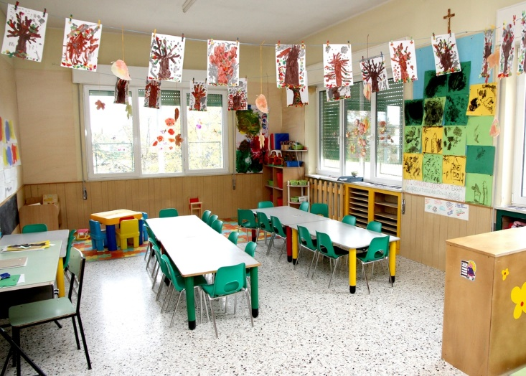
Effective Instructional Practices for Teaching Positive Behavior
  Teacher provides verbal (or other) reinforcement for achieving academic goals and for meeting behavioral expectations.
    Teacher refrains from using reprimand.
    The classroom is arranged to minimize distractions.
Notes:
Additional essential behavior management practices are listed below:
The classroom arrangement is conducive to learning. The student has access to pertinent areas, people, or materials.
The student is likely to get attention from staff for doing what is expected.
Brainstorm ideas to minimize distractions in the classroom pictured on the slide.

Slide 18

Evidence-based Interventions for Behavior
  Before a student is referred for a special education evaluation, documentation of clear and consistent behavior management interventions across the school and/or classroom must be made.
  Forming an intervention plan
  Providing documentation
  Monitoring
  Reviewing
Notes:
Source: Instructional Decision-Making Procedures: Ensuring Appropriate Instruction for Struggling Students Grades K-12 (2014 University of Texas System/Texas Education Agency)
Before a student is referred for a special education evaluation, documentation of clear and consistent behavior management interventions across the school and/or classroom must be made. A referral to special education is appropriate only when a student continues to present challenging behavior despite intervention practices
whose effectiveness is evidenced by the majority of students meeting the behavioral expectations. A particular student’s behavior pattern must clearly differentiate him or her from other students. If more than 10% of students in a particular classroom or overall school have difficulty meeting a particular behavioral expectation, then school
staff should first develop and implement a plan to help all students meet this expectation before individual supports are developed. It is only when sound school-wide programming and promotion of appropriate behavior is documented and found to be ineffective for a particular student that individualized supports should be developed.
Additional evidence-based interventions for behavior include:
Write an intervention plan for student behavior.
Document implementation of the systematic behavioral intervention indicated in the intervention plan over a reasonable period of time.
Monitor student progress regularly and frequently and adjust classroom factors.
Review assessment findings and refine the behavioral intervention.

Slide 19

Life as a Teacher
Notes:
A day in the life of a Special Education teacher
This is a profile of the SCB, or school community based special education program at James Hubert Blake high school in Montgomery County, Maryland. A team of teachers, administrators and specialists come together each day to support and teach these students.
http://youtu.be/qh1meBo_m1w

Slide 20
Working with Children Who Have Special Needs
Notes:
Educators play an important role in identifying and caring for children with special needs. Through training and experience, educators understand normal patterns of child growth and development. They understand the sequence and age level for developing skills. When an educators sees a major delay or problem in a child’s development, the child is referred to a specialist or other professional for assessment.
Remember that children develop at different rates and that the range of “normal” development is broad. However, early detection of developmental problems is important. The sooner a child is referred, the sooner he or she can begin receiving help.

Slide 21

Roles Of Special Needs Professionals
  Appreciation of individual differences
  Arranging the environment
  Assessment
  Encouraging cooperation
  Encouraging independence
  Encouraging positive interactions
  Mainstreaming/Inclusion
  Schedule planning
Notes:
As a professional of special needs children, you have many important roles to fulfill such as:
Appreciation of individual differences – Each child has special qualities which make him or her different from every other child. Educators should develop positive attitudes about individual differences in children. Such attitudes help educators serve as role models for children in their care. Educators should be aware of their own biases and feelings about children with disabilities or gifted children.
Arranging the environment – Rooms should be arranged so that children can move around freely and have easy access to all areas used. There should be a large open area for group activities and large muscle play. Several small areas should be planned for learning centers, small group activities or private, quiet activities. Avoid rearranging rooms, especially when children have physical or visual disabilities.
Assessment – Assessment involves a detailed evaluation of a child’s growth and development. Professionals determine the child’s areas of strengths and weaknesses and may be able to diagnose certain disabilities. Several professionals may participate in the assessment depending on the child’s needs. Educators can assist children with special needs by giving them individualized care. Such care should be based on a professional assessment and recommendation.
Encouraging cooperation – Promote positive interactions by providing materials and learning experiences which encourage cooperation. Such materials as blocks, dramatic play props and table games encourage children to play together. Plan learning experiences that give children a chance to interact positively.
Encouraging independence – Independent living is a major lifetime goal of children with disabilities. Educators may be tempted to perform tasks for children with disabilities but should avoid these temptations. Children with disabilities should be allowed to perform everyday tasks that they can do for themselves. This accomplishment builds self-confidence and gives a sense of independence to these children. Children can learn to care for their own needs through new and repeated experiences.
Encouraging positive interactions – There are many benefits when all children, with and without special needs, are educated and cared for together. Positive group interactions do not happen automatically. Educators must work to encourage positive group interactions. Plan and follow a well-balanced daily schedule to allow time to for positive interactions.
Mainstreaming/Inclusion – Mainstreaming is the process of placing individuals with disabilities into the general education or community environment. In mainstreaming, as in partial inclusion, an individual with a disability’s home classroom is a special education classroom; however, students who are mainstreamed will spend most of their day learning side-by-side with their general education peers. In mainstreaming, the students are usually expected to keep up with the rest of their peers without significant supplementary aids and support services. This supports and values having individuals with disabilities interact with students without any disabilities. Inclusion is a philosophy that states all individuals, regardless of ability, should participate within the same environment with necessary support and individualized attention. Children need caring adults to provide love security, safety and a positive environment. They need good surroundings to stimulate and support their development.
Schedule planning – The daily schedule may need to be more structured than usual for children with special needs. Much unstructured playtime may be difficult for such children. During a scheduled free choice time, limit the number of choices given and spend a few minutes directing the child in a specific activity.
A well-balanced schedule should include carefully planned transition activities. Check on the child’s status in terms of task completion. If needed, delay the transition or remind the child in advance that an activity period is ending.
What is mainstreaming? Why is the term inclusion often used?
What strategies may an educator use for creating a positive mainstreamed environment?
What are four guidelines for educators working with children with disabilities?

Slide 22

Instructional Strategies for Classrooms
  Best practices in instructional strategies include the use of three types:
    Direct instruction used for the entire class
    Small group instruction for a portion of the class
    Differentiated instruction for an individual student
Notes:
The choice of instructional strategies may mean the difference between success and failure for many learners with special needs.
Best practices in instructional strategies include the use of three types:
Direct instruction used for the entire class
Small group instruction for a portion of the class
Differentiated instruction for an individual student

Slide 23

Modifying Your Instruction to Accommodate the Special Needs Students
  The developmental areas of importance can include:
    attention and memory
    concept development
    functional use of objects and symbolic play
    pre-vocabulary/vocabulary
    self-direction
Notes:
As an educator, you will be responsible for modifying your instruction to accommodate the special needs students. The developmental areas of importance can include:
attention and memory
auditory localization and object permanence
concept development
conversation skills
fine motor skills (tactile integration, reaching, grasping, releasing, manipulation and bilateral skills)
functional use of objects and symbolic play
gross motor skills (prone, supine and upright)
imitation
motor and visual object permanence
pencil control and copying
pre-vocabulary/vocabulary
problem-solving
responses to communication from others
self-direction
self-help skills (eating, dressing, grooming)
social skills
sound and gestures
understanding space
visual-motor skills
visual perception
visual pursuit and object permanence

Slide 24
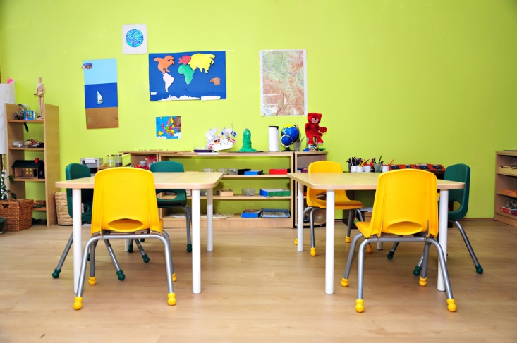
Modifications versus Accommodations
Notes:
What is the difference between a modification and accommodation?
Texas Education Agency
Content Modifications vs. Instructional Accommodations
http://www.texasprojectfirst.org/ModificationAccommodation.html

Slide 25
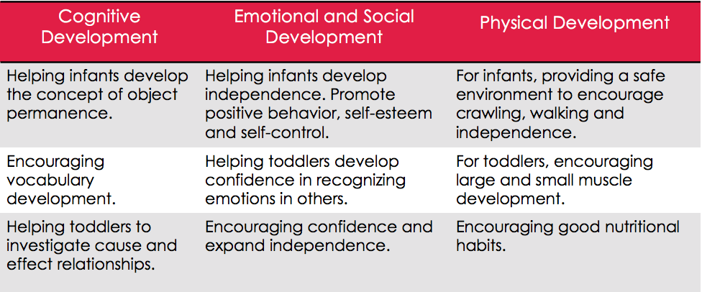
Strategies for Optimizing the Development of Infants and Toddlers with Special Needs
Notes:
Infants and Toddlers with Special Needs (newborn through two years)
Cognitive Development:
Helping infants develop the concept of object permanence.
Encouraging vocabulary development.
Helping toddlers to investigate cause and effect relationships.
Emotional and Social Development:
Helping infants develop independence. Promote positive behavior, self-esteem and self-control.
Helping toddlers develop confidence in recognizing emotions in others.
Encouraging confidence and expand independence.
Physical Development:
For infants, providing a safe environment to encourage crawling, walking and independence.
For toddlers, encouraging large and small muscle development.
Encouraging good nutritional habits.

Slide 26
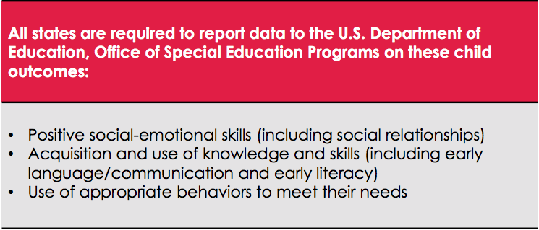
Strategies for Optimizing the Development of Preschoolers with Special Needs
Notes:
Source: The Early Childhood Outcomes Center, November 2009
Eligible children with disabilities, ages 3-21, are entitled to receive a free appropriate public education (FAPE) under the Individuals with Disabilities Act (IDEA). In Texas, school district Preschool Programs for Children with Disabilities (PPCD) provide special education and related services for eligible children with disabilities ages 3-5. PPCD refers to the services provided by the school district, not to the place where they are provided. Eligible children may receive PPCD services in a variety of settings such as pre-kindergarten, resource and self-contained classrooms or in community settings such as Head Start and pre-school.
The Early Childhood Technical Assistance Center
The outcomes team of the ECTA Center provides national leadership in assisting states with the implementation of high-quality child and family outcomes measurement for early intervention and early childhood education.
http://ectacenter.org/eco/

Slide 27
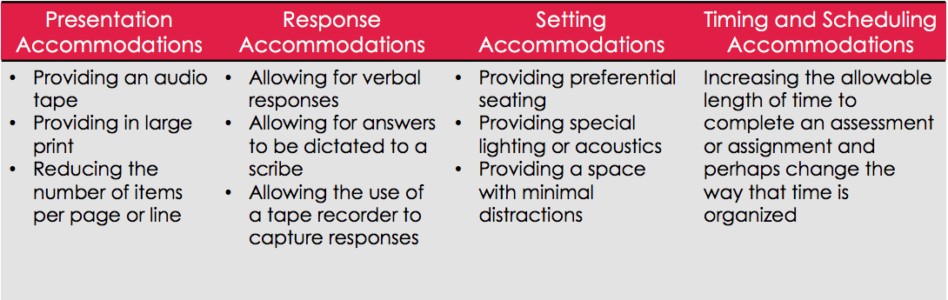
Strategies for Optimizing the Development of Special Needs Children in the Early to Middle Childhood Stage
Notes:
Source: The University of North Texas in partnership with the Texas Education Agency
Early to middle childhood stage (ages six through ten years)
Presentation Accommodations
Is there a problem with the way in which the student can see, hear, or read the lesson? Allow students to access information in ways that do not require them to visually read standard print. These alternate modes of access are auditory, multi-sensory, tactile and visual. Example of presentation accommodations include:
• Presenting instructions orally
• Providing a designated reader
Response Accommodations
Does the student have problems manipulating items, or is there something that might pose a problem with the student due to the way in which a response is required? If
possible, change the response. By changing the response, you can allow students to complete activities, assignments and assessments in different ways or to solve or
organize problems using some type of assistive device or organizer.
Setting Accommodations
If the student has a problem focusing on work when there are a large number of students in the class, this may be a possible choice. These students can be easily distracted by others or have behaviors that are distracting to others. Change the location in which a test or assignment is given or the conditions of the assessment setting.
• Administering a test in private room or alternative test site
• Administering a test in small group setting
Timing and Scheduling Accommodations
Increase the allowable length of time to complete an assessment or assignment and perhaps change the way that time is organized.
Timing
• Allowing frequent breaks
• Extending allotted time for a test
Scheduling
• Administering a test in several timed sessions or over several days
• Allowing subtests to be taken in a different order
• Administering a test at a specific time of day

Slide 28
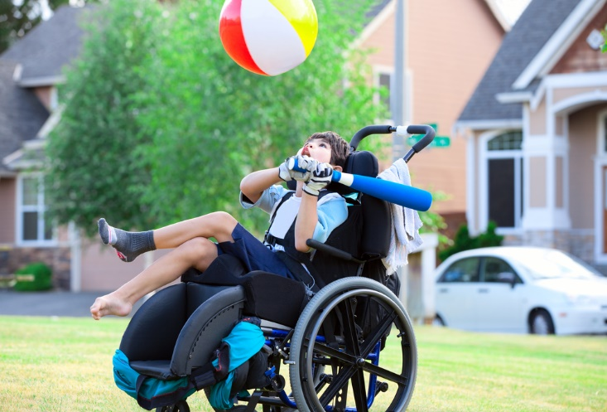
What else should you know?
Notes:
Remember:
Avoid euphemisms like “physically challenged” or “differently abled”.
Using old world words such as “crippled” or handicapped” is also inappropriate.
Students with disabilities are not victims – they do not “suffer from cerebral palsy or mental retardation”.
Also when referring to students in wheelchairs – they use the chair and are not “confined” to it.
Source: Texas A&M AgriLife Extension

Slide 29
The Individuals With Disabilities Education Act (IDEA)
  Who qualifies as a child with special needs?
  What are four examples of environmental factors which can create special needs in children?
  What is a disability?
  Provide four examples of effective instructional practices for teaching positive behavior.
  What are examples of strategies for optimizing the development of infants and toddlers with special needs? Preschoolers? Early to middle childhood stage?

Slide 30

Questions
Notes:
Remember:
Avoid euphemisms like “physically challenged” or “differently abled”.
Using old world words such as “crippled” or handicapped” is also inappropriate.
Students with disabilities are not victims – they do not “suffer from cerebral palsy or mental retardation”.
Also when referring to students in wheelchairs – they use the chair and are not “confined” to it.
Source: Texas A&M AgriLife Extension

Slide 31
References and Resources
  Images:
    Photos obtained through a license with Shutterstock.com.™. (Slides 4, 5, 6, 7, 8, 9, 10, 11, 12, 13, 14, 15, 16, 17, 18, 19, 21, 22, 23, 24, 28 and 30)
  Textbook:
    Decker, C. (2011). Child development early stages through age 12. (7th ed.). Tinley Park: Goodheart-Willcox Company, Inc.
    Decker, C. (2004). Children: the early years. (5th ed.). Tinley Park: Goodheart-Willcox Company, Inc.
  Websites:
    Building the Legacy: IDEA 2004
    The Individuals with Disabilities Education Act (IDEA) is a law ensuring services to children with disabilities throughout the nation. IDEA governs how states and public agencies provide early intervention, special education and related services to more than 6.5 million eligible infants, toddlers, children and youth with disabilities.
    http://idea.ed.gov
    Texas Education Agency
    Special education: About one of every eight Texas public school students needs special education services. A wide array of services and support are available for these students and families.
    http://tea.texas.gov/Curriculum_and_Instructional_Programs/Special_Education
    Texas Woman’s University
    Least Restrictive Environment (LRE), Inclusion and Mainstreaming.
    http://www.twu.edu/inspire/least-restrictive.asp

Slide 32
References and Resources
  Websites:
    The Early Childhood Technical Assistance Center
      The outcomes team of the ECTA Center provides national leadership in assisting states with the implementation of high-quality child and family outcomes measurement for early intervention and early childhood education.
      http://ectacenter.org/eco/
    University of Texas System/Texas Education Agency 2014 Instructional Decision-Making Procedures: Ensuring Appropriate Instruction for Struggling Students Grades K-12.
      http://resources.buildingrti.utexas.org/PDF/Instructional_Decision-making_Procedures.pdf
    U.S. Equal Employment Opportunity Commission
    The law requires an employer to post a notice describing the federal laws prohibiting job discrimination based on race, color, sex, national origin, religion, age, equal pay, disability or genetic information.
    http://www.eeoc.gov/employers/upload/poster_screen_reader_optimized.pdf
    U.S. Department of Justice
    A Guide to Disability Rights Laws.
    http://www.ada.gov/cguide.pdf
  YouTube™:
    A day in the life of a Special Education teacher
      This is a profile of the SCB, or school community based special education program at James Hubert Blake high school in Montgomery County, Maryland. A team of teachers, administrators and specialists come together each day to support and teach these students.
      http://youtu.be/qh1meBo_m1w

