Slide 1
The Importance of Effective Communication
Introduction to Cosmetology
Notes:
Introduce topic and slide presentation.

Slide 3
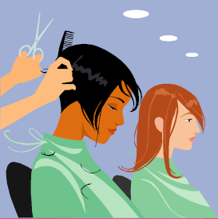
  How do you think a client would feel if they were trying to talk to you and you were on your cell phone?
Notes:
Discuss.

Slide 4
Instructional Objectives
  Be able to communicate and behave in a professional manner when dealing with clients
  Use effective communication techniques when dealing with clients

Slide 5
Communication
  Exchange of information by thoughts, opinions, or information by speech, writing or signs
  Sometimes the message you send is not always the message that is received

Slide 6
Types of Effective Communication
  Verbal
  Non-verbal
Notes:
Effective Communication
A. Verbal communication
1. Power of what you say: Be sure to be knowledgeable about what you say to people.
2. Inflection: Change in pitch or tone of voice
3. Tone: Pleasant tone of voice communicates the idea that you want to express.
4. Grammar: Using the standard grammar will gain respect from your clients. Using slang will turn them off.
5. Conversational manners: Be sensitive, tactful, honest without offending your clients and co-workers.
B. Non-verbal communication
1. Gestures: Body language
2. Eye Contact: Looking at the person is acknowledgement that you are listening. Do not roll your eyes.
3. Appearance: Looking professional will get a client’s positive attention.
4. Facial expressions: Worth a thousand words.
5. Body language
1. Negative: Arms crossed, scowl on your face, not smiling.
2. Positive: Arms open, standing tall and confident, and smiling

Slide 7
Verbal Communication
  The use of sounds and language to communicate
Notes:
Practice verbal skills daily.

Slide 8

Non- Verbal Communication
  Communication that is not spoken, but interpreted through body language and facial expressions
Notes:
Allow students to brainstorm examples of non-verbal communication.
Communication can also be written (letters/flyers/signs) or electronic (email).
Discuss the importance of correct grammar and spelling on salon flyers and signage. What does this say to potential clients?
Discuss email etiquette.

Slide 9
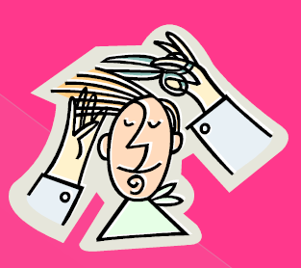
Attitude and Manners Matter
Notes:
3. Personality qualities
A. Attitude: Can affect others around you. Attitudes are learned, positive/negative. They can be changed for the better.
B. Manners: Good human relations, kind and considerate.

Slide 10
It Matters How You Say It
Notes:
Distribute handout It Matters How You Say It! (see All Lessons Attachments tab) and allow students to practice using a different tone of voice and inflection when asking the question, “What do you want me to do?”

Slide 11
Personal Qualities
  Maintain professional appearance, personal hygiene and behavior
  Demonstrate correct client care and professionalism at all times
  Project professionalism, confidence and enthusiasm when providing information
Notes:
Your personal qualities play an important role in how your non-verbal communication is perceived by your clients.

Slide 12
Structure of Conversation
  Communication with clients
  In salon communication with co-workers
Notes:
4. Structure of conversation
A. Client communication: Direct the conversation. Do not gossip or complain. Do not talk about personal issues, politics or religion. Talk about beauty and fashion. Be a good listener.
B. In-salon communication with co-workers: Same as above applies.

Slide 13
Telephone Etiquette
  Greeting
  Introduction
  Tone
  Ask questions
  Listen
  Salon script
Notes:
2. Telephone ethics
A. Greeting: The first thing that you say when you pick up the phone.
B. Introduction: Your name
C. Tone: Pleasant and happy.
D. Ask questions: Double check the information being requested by asking questions. Do not make assumptions.
E. Listen: Carefully to what the client is saying.
Discuss the script you want used when answering the cosmetology classroom telephone.
Have each student develop a basic script for a salon, record on their phone and play it back for the class to evaluate.

Slide 14
Communication with Clients
  Provide good customer service
  Demonstrate respect to clients
  Explaining treatment/service/product to the clients
  Demonstrate good communication skills

Slide 15
  5 tips for building better communication skills in the salon
  (Click on link)
Notes:
View and discuss. Have students provide additional examples.

Slide 16
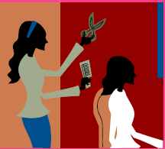
In-Salon Communication with Co-Workers
  Demonstrate respect to colleagues
Notes:
Discuss the importance of communicating effectively with co-workers.

Slide 17
  Adapt methods of communication to suit different situations and client needs
Notes:
Have students provide examples

Slide 18
  How to handle an angry client
  (Click on link)
Notes:
View and discuss.

Slide 19
  Tips for client follow-up
  (Click on link)
Notes:
View and discuss.

Slide 20
Questions?

Slide 21
References and Resources
  Images:
    Microsoft Office Clip Art: Used with permission from Microsoft.
  Textbook:
    Alpert, Arlene. Milady's Standard Cosmetology. Clifton Park, NY: Thomson Delmar Learning, 2008. Print.

