Slide 1
The Tech-Savvy Traveler
Travel and Tourism Management

Slide 3

Tech-Savvy
Notes:
Well informed about or proficient in the use of modern technology, especially computers.

Slide 4

Technology
Notes:
The application of scientific knowledge for practical purposes, especially in industry.

Slide 5
Computer Reservation Systems Global Distribution Systems
Notes:
Customer Reservation System (CRS) is a computer system that allowed users to reserve and book airline tickets, cruises, lodging, tours and more.
Global Distribution System (GDS) - formerly the computer reservation system.

Slide 6
CRS and GDS
  Customer Reservation System
    1960’s – airlines generated fast, effective and accurate booking technologies
    1970’s - extended booking capabilities to travel agents
    Short time later - extended to hotels, car rentals and others
  Global Distribution System
    CRS renamed to GDS during expansion
    The Internet became a valuable tool
    The GDS was made into a web-based system
Notes:
Customer Reservation System (CRS) was the first system created in the 1960’s by the airline companies to make fast and accurate bookings.
Prior to this (networked computers), reservations and bookings were made by telephone, fax, mail and in person.
During the 1970’s, the system extended to travel agents.
A short time later it extended further to hotels, car rentals and others.
To reflect the expansion, the CRS system was renamed to GDS or Global Distribution System.
As the Internet grew, the GDS was made into a web-based system more user-friendly system.

Slide 7

Travel Agents
  Past
    Airlines paid commissions
    10% for each ticket sold
    Cheaper than airline staff
    Travel agents and airlines benefitted
  Recent
    Airlines stopped paying commission
    Online agencies appeared
    Travel agents began selling more complex travel such as cruises and tours
Notes:
In the past, travel agents were paid a 10% commission to book flights. The airlines realized it was cheaper than hiring and maintaining their own staff.
More recently, when anyone could make a reservation, the airlines stopped paying commissions to travel agents.
With the continued growth of the Internet, online agencies appeared such as:
ExpediaTM
OrbitzTM
TravelocityTM
TripAdvisorTM.
The airlines realized they no longer needed to maintain their GDS systems and sold them to other companies.
Currently the Web and GDS remains the principal distribution channel whether bought by individuals or through agencies.

Slide 8
Types of Travel Websites
  Auction
    Permits consumers to bid on travel
  Blogs
    Self-proclaimed experts giving their opinion on destinations and products
  Bookings
    Airlines, car rentals and hotels sell travel directly to customers
  Informational
    Provide details on places, products and data
  Travel Agencies
    Traditional and online – provide guidance and advice
Notes:
If you entered travel into a search engine such as GoogleTM or BINGTM, you would get millions, perhaps, hundreds of millions of sites. If you try categorizing them, you will find there are five major types of travel and hospitality sites.
Auction – these sites allow customers to bid on travel. The customer enters a price and the site will tell you if your bid was accepted. Only those customers who are well informed will know what price to offer to ensure a good price for the product. It may be easy to overpay. Example: Priceline
Blogs – experts, or self-proclaimed experts love to give their opinion on everything and reviews on travel destinations, cruises, excursions and tours. They will also give their opinion on everything related to travel such as what to pack, what hotels to use or avoid, what sites to see, exchange rates and more.
Bookings – airlines, car rentals, and lodging sites will try to sell their products directly to the public and encourage you to make a reservation directly on their company site. It is the cheapest way for them to complete a transaction. Cruise lines and tour operators also have booking sites, but find that most go to their sites for research and information.
Informational – provide details on place, products, weather information, maps and typically with links to other professional travel organizations such as travel agents or tour operators. But be careful, anyone can publish to the Internet and the information is not always current, accurate, or truthful.
Travel agencies – traditional and online – provide guidance and advice. Examples: ExpediaTM, OrbitzTM, TravelocityTM and TripAdvisorTM

Slide 9
Internet Travel Purchases
  Advantages
    Access to lots of information
    Convenient
    Communicates regularly
    Customizable
    Entertaining
    Interactive
    No sales pressure
    Visual
  Disadvantages
    After purchase problems
    Cannot solve complex trips
    Dated information
    Poor advice
    Privacy and security issues
    Time consuming
Notes:
Advantages:
Access to lots of information – sometimes so much that it can be overwhelming.
Convenient – research and buy anytime, anywhere – 24/7.
Communicates regularly – sends you emails with special announcements or offers.
Customizable – can create a profile just for you.
Entertaining – travel websites can be creative and fun.
Interactive – quick, flexible and accurate.
No sales pressure – allows you to think before purchasing.
Visual – may provide virtual tours of hotels and cruises and more.
Disadvantages:
After purchase problems – no one to call or difficult to connect to a live person for help.
Cannot solve complex trips – may need assistance.
Dated information – website may not be updated frequently.
Poor advice – cannot answer open- ended questions.
Privacy and security issues – people still are wary of providing credit and personal information.
Time consuming – too many choices and data can be overwhelming.

Slide 10
Social Media and Travel
Social Network
Business
Microblogs
Photo and Video Sharing
LinkedIn™
Twitter™
Instagram™
YouTube™
Facebook™
Notes:
Social media plays a vital part in travel. It has motivated people to travel more.
People often “post” vacation photos and videos on social networks and video sharing sites, “tweet” about travel venues on microblogs and even network with businesses.
Can you name any other media?

Slide 11
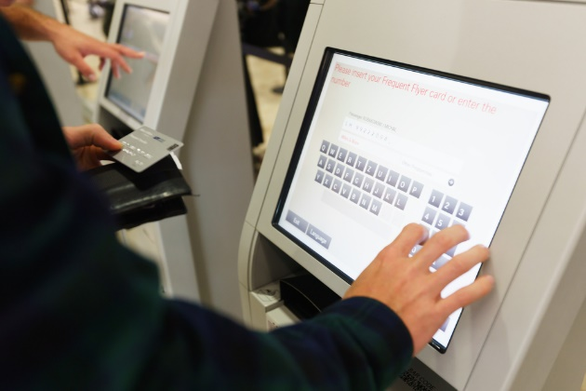
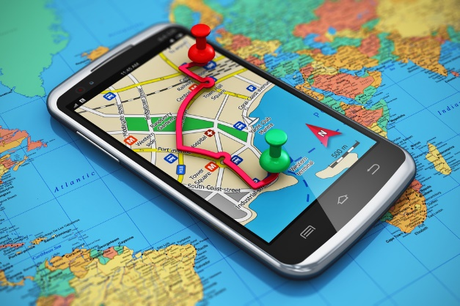

Additional Travel Technology
  3-D Movie Systems
  Apps
  Global Positioning System (GPS)
  Kiosks
  Skype
  Smart phones and tablets
Notes:
Additional travel technology:
3-D movie systems - enhance parks and touring
Apps - allow tracking of children for example, on a cruise ship
Global Positioning System (GPS) - enhanced car rental industry
Kiosks - facilitate check-in and out at hotels and airports
Skype-like technology allows you to see people such as travel agents live on your computer
Smart phones and tablets – may solve trip changes faster
Can you think of any other technology that the travel industry can use?

Slide 12

Notes:
What do you think is next in technology for the travel and tourism industry?

Slide 13
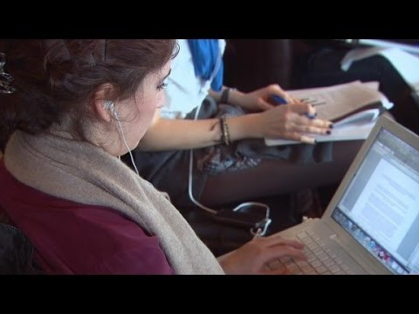
Technology has Changed the Way We Travel
  (Click on link)
Notes:
Click on hyperlink to view video:
Technology has changed the way we travel
Traveling today is different than just 5 years ago. Why? Because of technology.
https://youtu.be/gTNjGQgwOGA

Slide 14

Notes:
What does this quote mean to you?

Slide 15
Let’s Review!
  Who is a tech-savvy person?
  When was the first customer reservation system started?
  What is the customer reservation system called now?
  What are the types of travel websites?
  Name some advantages and disadvantages of Internet travel purchases.
  How has social media influenced travel?
  What other travel technology is available?
  What do you think is next for travel technology?
Notes:
Answers to the questions are found within the slide presentation or may vary with class discussion.

Slide 16

Questions?

Slide 17
References and Resources
  Images:
    Shutterstock™ images. Photos obtained with subscription. (Slides 3, 4, 7, 11, 12, 14, 16)
  Textbooks:
    Mancini, M. (2013). Access: Introduction to travel and tourism. Clifton Park, NY. Cengage Learning.
    Reynolds, J. S. & Chase, D. M. (2010). Hospitality services. Tinley-Park, Illinois: The Goodheart-Willcox Company.
  YouTube™:
    Technology has changed the way we travel
    Traveling today is different than just 5 years ago. Why? Because of technology.
    https://youtu.be/gTNjGQgwOGA

