Slide 1
The Teen Years
Human Growth and Development

Slide 3
Terms
Abstract thought: The capacity to consider "what if" situations, to create sophisticated arguments, and to reason from different points of view
Adolescent: Teen
Depression: Feelings of intense sadness last for long periods of time and prevent a person from leading a normal life
Estrogen: A hormone produced by the ovaries
Personal identity: A sense of oneself as a unique individual
Testosterone: A hormone produced by the testicles

Slide 4
Biological, Cognitive, Emotional, Social and Development

Slide 5
Biological Development of Children Teens

Slide 6
Physical Development
Boys
    Height: 70 inches
    Weight: 150 pounds
Girls
    Height: 64 inches
    Weight: 125 pounds

Slide 7
Sexual Development
Boys
    Puberty begins between 13 and 15 years
      Begins with production of testosterone
      Changes
        Increased body hair
        Production of sperm
Girls
    Puberty begins between 11 and 12 years
      Beings with production of estrogen
      Menstruation

Slide 8
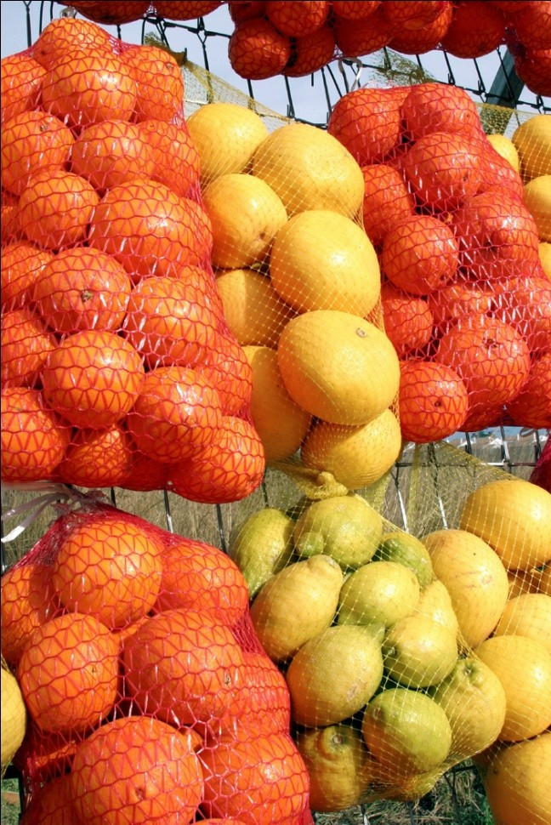
Nutrition
Eat a well balanced diet
Remain physically active
Get plenty of sleep

Slide 9
Cognitive Development of Teens

Slide 10
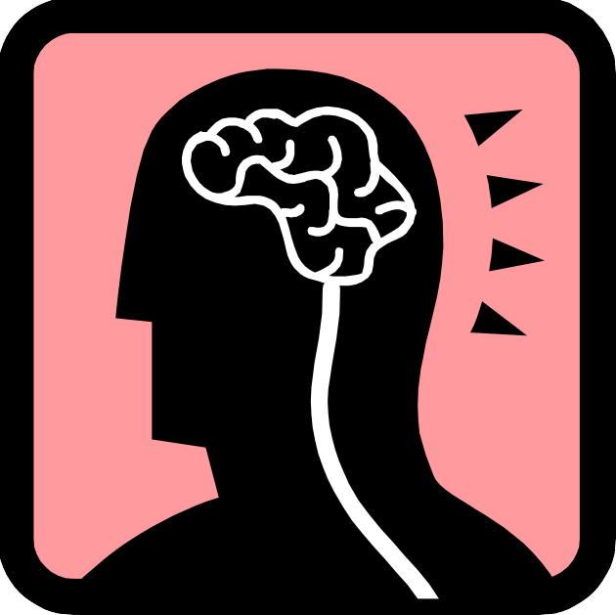
Cognitive Development
Abstract thinking
Capable of better judgment

Slide 11
Emotional Development of Teens

Slide 12

Emotional Development
Personal identity
Desire for independence

Slide 13
Emotional Development of Teens

Slide 14
Emotional Development
Learning to cope with:
Depression
Anxiety

Slide 15
Social Development of Teens

Slide 16

Social Development
Peers
Friends
Dating

Slide 17
The Influences of Family and Society on Teens

Slide 18

Family Influences
Teach values and morals
Provide guidance

Slide 19
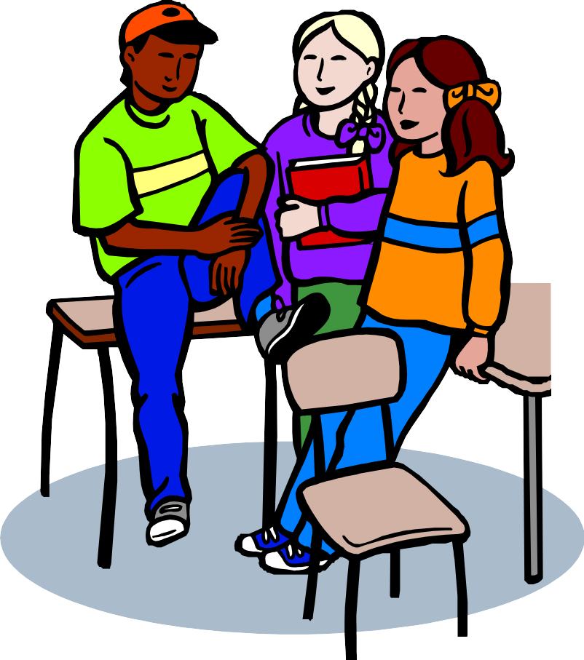
Societal Influences
Media
Peers
Friends

Slide 20
Guidance Techniques for Teens

Slide 21
Piaget’s Theory
Vygotsky’s Theory
Formal operations
    Abstract thinking
      “What if ” scenarios
      Can argue from differing points of view
      Can apply learning to real-world situations
Social interactions
Zone of proximal development
    Group assignments

Slide 22
Resources and References
Images:
Microsoft Office Clip Art: Used with permission from Microsoft.
Textbook:
Brisbane, H. (2010). The developing child. Columbus, OH: Glencoe/McGraw-Hill.

