Slide 1
The Use of Technology in Counseling and Mental Health

Slide 3
Digital Explorers
Notes:
Technology is advancing more and more every day. The majority of our lives are spent on online. Think about how much you use technology. How old were you when you first used a computer? Laptop? Cell phone with Internet capabilities? Most of you would be considered digital natives. Individuals with a limited use and knowledge of technology are considered digital immigrants. Technology is not going away. In fact, it is changing and advancing every day. Technology is used in most professions and has become an integral component in those practices. In the field of counseling and mental health, individuals have seen the potential technology can offer to clients and counselors. Let’s explore the digital capabilities of technology in counseling and mental health.

Slide 4
What is telehealth?
Notes:
Telehealth activities refer to the use of digital technology to provide individuals clinical services, such as assessment and treatment by the use of:
Blogs
Chats
E-counseling
E-mail
E-therapy
Forums and social networks
Gaming
Interactive televideo communications such as Skype™ or via virtual reality (VR)
Online counseling
Online therapy
Podcasts
Tele-medicine
Virtual reality environments
Websites
Wikis

Slide 5
What are the advantages of using technology?
Notes:
The advantages of using technology include lower cost and less travel, as well as simple availability of therapy in remote areas lacking clinical facilities. Teletherapy options can be used with clients who are confined at home due to physical limitations or panic anxiety disorders. Within correctional facilities and Veterans Administration (VA) hospitals, a telepsychiatry clinic provides care to inmates or patients experiencing transfers, makes their medical records more transferrable, and eliminates difficulties associated with using an offsite clinic.

Slide 6
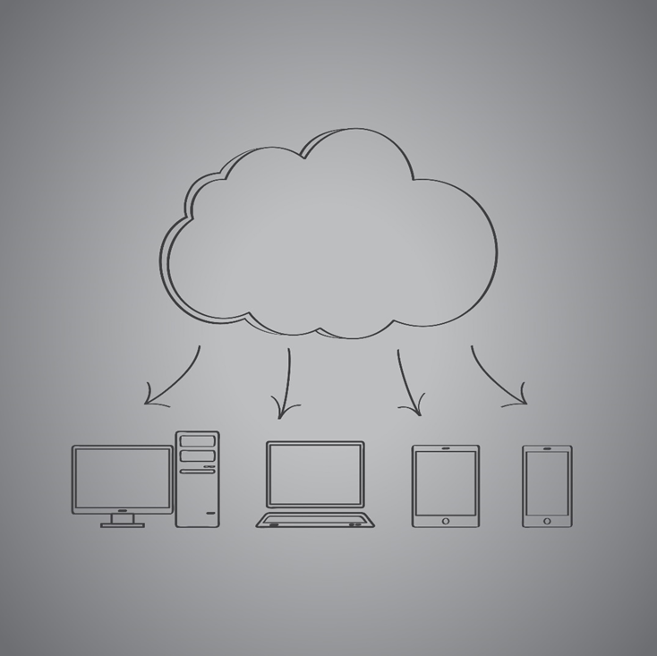
Counseling Accessed Over Electronic Media
Counseling and treatment via Skype™ sessions
Creating appointments
Payment methods
Worldwide counseling
Notes:
Just by a quick Internet search, an individual can locate pages of websites offering online counseling for a fee. Individuals can create appointments which can be booked online. Skype™ sessions can be paid for online by the use of credit cards. Individuals should be aware of websites that are less reliable and be more apt to take advantage of quackery than professional counseling. As electronic media becomes more sophisticated, treatments and counseling services might become easily accessible online. Any number of services to address any number of problems, from depression to substance abuse, may become available to clients in any part of the world.

Slide 7
Skyping
Notes:
How are some therapists using video conferencing to reach clients? Therapists are able to help clients on the spot. Some clients can have a Skype™ session with a counselor before he or she goes to work or at home. Some clients can utilize this method while out of town, such as on a vacation. For example, if a client is experiencing a panic attack, he or she can e-mail the therapist for a quick 20-minute mini-session. Video conferencing has been an increasingly accepted way to reach clients in hospitals, prisons, veterans’ health care facilities and rural clinics, which are all supervised sites. If a client lives in a rural area, video conferencing is an ideal pathway for counseling and treatment.

Slide 8
Virtual School Counseling
School counselors may opt for virtual or online school interactions such as:
E-mail
Online instant messaging
Telephone calls
Text messages
Video chat
Webinars
Notes:
As a school counselor, you may opt for virtual or online school interaction with students and parents. E-mail, online instant messaging, telephone, text message or video chat are some of the methods for communicating with students and parents.
In addition to one-to-one counseling, a school counselor can also create webinars on topics such as self-esteem, cyberbullying and finding the right college.
The American School Counselor Association, a division of the American Counseling Association, estimates that less than 1 percent of its members are counselors at online or virtual schools.
What are the advantages and disadvantages of this type of school counseling?
Do our school counselors use any of these technology methods?

Slide 9
Games as Counseling Tools
Providing an empathy angle
Teaching compassion
Helping clients manage their emotions
Providing a supplemental counseling tool
Notes:
Video game designers are understanding the benefits of designing games with an “empathy” angle. Some video game designers have begun to create games with storylines that attempt to teach compassion or help the players manage their emotions. Games can teach individuals, especially children, about self-discipline, self-esteem and communication skills. Gaming should be viewed as a supplemental tool rather than a substitution for counseling.
Can you think of any games you have played with this type of storyline?

Slide 10
Use of Video Games in Therapy
Notes:
Click on hyperlink to view YouTube™ video:
Modern Technology in Cognitive Behavior Therapy (CBT) Treatment
At a recent Beck Institute Workshop, Dr. Torrey Creed provides an anecdote to illustrate how the use of video games can be helpful in CBT treatment, particularly with children and adolescents.
https://youtu.be/j8L4b0WpAIc

Slide 11
Blogging for Counselors
Blogging can:
Help counselors disseminate information
Help increase client base
Help counselors network with other counselors
Provide training and counseling
Notes:
A blog – short for web log – is an online journal, usually written in the first person and taking an informal tone. If you search the Internet on any mental health topic such as eating disorders in teenagers, group therapy for divorced individuals or depression among college students, you’ll find an abundance of blogs. School counselors are utilizing blogs to share information. Blogging can be a platform for counselors to provide training and counseling. It can help build a private practice for therapists. For counselor educators, blogging can provide an avenue to share information with colleagues and technology-native students.

Slide 12
Technology and Imaging of the Brain
Computerized axial tomography (CAT scan)
Fast magnetic resonance imaging (fMRI)
Magnetic resonance imaging (MRI)
Positron emission tomography (PET)
Skull radiograph
Notes:
Technology has been used to take images of the brain.
Brain imaging allows physicians and scientists to “see” inside the head at the brain. Imaging has several benefits. It permits the study of the relationship of a brain area to function, assists with the location of neurological disorders, and helps with the treatment of those disorders.
Skull radiograph – X-rays – a one dimensional x-ray of the skull, must take at least three angles (front, side, and 45 degree angle) to determine abnormalities and fractures
Computerized Axial Tomography scan (CAT scan or CT scan-computed tomography scan) - a moving ring around the head sends x-ray beams around and through the head to create cross-sectional images to show a three dimensional structure but not function
Magnetic Resonance Imaging (MRI) – the use of radio frequency signals, produced by displaced radio waves within a powerful magnetic field which the person lies in, provides an anatomical view of the brain but not function
These methods of imaging will show snapshots of the brain but not the function of the brain. To view the brain at work, two types of imaging are used:
Positron Emission Tomography (PET) – radioactive sugar is injected into the person receiving the PET scan – the sugar is used more where the brain activity is higher – the PET scan will show the various levels of activity
Fast Magnetic Resonance Imaging (fMRI) – a functional MRI or fast type of MRI will also show the location of brain activity when performing different activities or listening to various sounds

Slide 13
Ethical Use of Technology in Counseling
Stay informed of the new changes pertaining to the use of technology in Counseling and Mental Health.
Clearly define for clients the pros and cons and the limitations and successes of the use of technology.
Notes:
As a Counseling and Mental Health Services provider, it is important to always be ethical and do a good job of clearly defining for clients the pros and cons and the limitations and successes of the use of technology. Counselors need to remember that when they provide services which utilize technology, it can be provided locally or across the nation and world. It is easy to disregard language, cultural and time zones differences. These are factors to take into consideration for having the world that is just a cyber-doorstep away. For up-to-date resources on the Code of Ethics, visit:
American Counseling Association
2014 ACA Code of Ethics Resources
http://www.counseling.org/knowledge-center/ethics/code-of-ethics-resources
What are the pros and cons of using technology in Counseling and Mental Health?
What are the limitations and successes of using technology in Counseling and Mental Health?

Slide 14
Code of Ethics
Notes:
Discuss the components of the code of ethics.
Marlene M. Maheu, PH.D.
American Association for Marriage and Family Therapy (AAMFT) Code of Ethics Addresses “Technology-Assisted Professional Services.”
http://telehealth.org/blog/aamft-code-of-ethics

Slide 15
Dissemination of Records
Use a cloud-based practice management system to provide storage, encryption and backup of electronically protected health information.
Notes:
Dissemination: To cause (something, such as information) to go to many people
As a Counseling and Mental Health Services provider, securing your clients’ personal information is of the upmost importance.
Using a practice management system that is cloud-based can benefit a practice by:
Better tracking system of monies collected and owed
Increased efficiency
Reduced overhead costs and tasks
Using a cloud-based practice management system from a HIPAA-compliant vendor is an excellent way to significantly reduce your HIPAA compliance risks and responsibilities. With a cloud-based practice management system vendor, counselors can relieve themselves of the responsibility of security compliance. The vendor can also provide storage, encryption and backup of electronically protected health information. It is a good idea for counselors to keep their own backups of protected health information.
According to Counseling Today, a publication of the American Counseling Association, it is important for counselors to keep the following information in case of an emergency:
Basic information: National Provider Identifier number, license information
Information about business banking accounts
Information about your accountant, attorney and other professionals with whom you consult
Insurance companies with which you are paneled. For health providers, medical credentialing is the process of getting networked with insurance companies (this is often described as "getting on insurance panels").
Location of any computers and devices used in your work
Location of client records
Login information for your cloud-based practice management system and other software containing pertinent business information
Passwords for any computers and devices used in your work

Slide 16
Apps for the 21st Century Therapist
Notes:
Click on the image, and discuss the twenty-three apps which are available. According to Mike Langlois, whether you are looking for games to play with patients, productivity or billing tools, or something to help you research, there’s an app for that.
Twenty-Three Apps for the 21st Century Therapist
Whether you are looking for games to play with patients, productivity or billing tools, or something to help you research, there’s an app for that.
http://gamertherapist.com/blog/2013/03/03/twenty-three-apps-for-the-21st-century-therapist

Slide 17
Review
What is telehealth?
What are three advantages of using technology in Counseling and Mental Health?
Describe three ways a counselor utilize Skyping in his or her practice.
How can the use of video games be helpful in CBT treatment, particularly with children and adolescents?
Why is it important to use a practice management system that is cloud-based?

Slide 19
References and Resources
Images:
Photos obtained through a license with Shutterstock.com™.
Textbook:
Rathus, Spencer A. (2007). Psychology: principles in practice. Holt Rinehart & Winston.
Websites:
American Counseling Association
2014 ACA Code of Ethics Resources.
http://www.counseling.org/knowledge-center/ethics/code-of-ethics-resources
American School Counselor
The American School Counselor Association (ASCA) supports school counselors’ efforts to help students focus on academic, career and social/emotional development so they achieve success in school and are prepared to lead fulfilling lives as responsible members of society.
https://www.schoolcounselor.org

Slide 20
References and Resources
Counseling Today
Finding technology’s role in the counseling relationship.
http://ct.counseling.org/2011/10/finding-technologys-role-in-the-counseling-relationship
Marlene M. Maheu, PH.D.
American Association for Marriage and Family Therapy (AAMFT) Code of Ethics Addresses “Technology-Assisted Professional Services.”
http://telehealth.org/blog/aamft-code-of-ethics
Person-Centered Tech
Emailing and Texting Security vs. The ACA 2014 Code of Ethics
https://personcenteredtech.com/2014/04/emailing-and-texting-security-vs-the-aca-2014-code-of-ethics-2nd-in-a-series

Slide 21
References and Resources
YouTube™:
Modern Technology in Cognitive Behavior Therapy (CBT) Treatment
At a recent Beck Institute Workshop, Dr. Torrey Creed provides an anecdote to illustrate how the use of video games can be helpful in CBT treatment, particularly with children and adolescents.
https://youtu.be/j8L4b0WpAIc

