Slide 1

The Balancing Act
Managing a Career and Family
Culinary Arts

Slide 2
Copyright
Copyright © Texas Education Agency, 2014. These Materials are copyrighted © and trademarked ™ as the property of the Texas Education Agency (TEA) and may not be reproduced without the express written permission of TEA, except under the following conditions:
1) Texas public school districts, charter schools, and Education Service Centers may reproduce and use copies of the Materials and Related Materials for the districts’ and schools’ educational use without obtaining permission from TEA.
2) Residents of the state of Texas may reproduce and use copies of the Materials and Related Materials for individual personal use only, without obtaining written permission of TEA.
3) Any portion reproduced must be reproduced in its entirety and remain unedited, unaltered and unchanged in any way.
4) No monetary charge can be made for the reproduced materials or any document containing them; however, a reasonable charge to cover only the cost of reproduction and distribution may be charged.
Private entities or persons located in Texas that are not Texas public school districts, Texas Education Service Centers, or Texas charter schools or any entity, whether public or private, educational or non-educational, located outside the state of Texas MUST obtain written approval from TEA and will be required to enter into a license agreement that may involve the payment of a licensing fee or a royalty.
For information contact: Office of Copyrights, Trademarks, License Agreements, and Royalties, Texas Education Agency, 1701 N. Congress Ave., Austin, TX 78701-1494; phone 512-463-7004; email: copyrights@tea.state.tx.us.
2
Copyright © Texas Education Agency, 2014. All rights reserved.

Slide 3
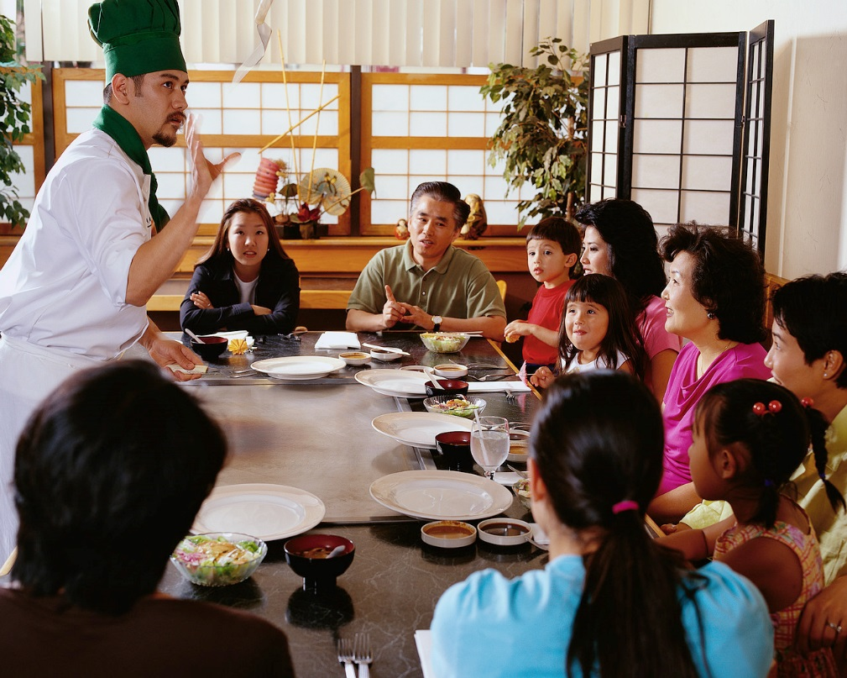
Working in the Food Service Industry
3
Copyright © Texas Education Agency, 2014. All rights reserved.
Notes:
The popularity of cooking shows on television has boosted careers for many chefs and cooks.
But along with the popularity of culinary skills comes advantages and disadvantages to working in the food service industry.

Slide 4
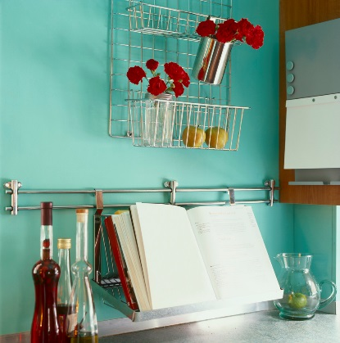
Advantages
Able to create new foods and menus
Work with exotic ingredients
Explore passion for food and cooking
Impress clients
Flexible shifts
Demand for chefs is constant
If full time:
  Health insurance
  Paid vacations
If you own a restaurant:
  Creative freedom
  Choose type of foods served
  Choice of specials each night
4
Copyright © Texas Education Agency, 2014. All rights reserved.
Notes:
There are many advantages to working in the food industry. Listed above are a few.
Can you think of any others?

Slide 5
Disadvantages
Can be physically and mentally overwhelming
Stressful
Long hours with few breaks
Always on your feet
Under pressure to deliver meals quickly
Burnout is common
Hours include holidays and weekends
Stiff competition
Can be monotonous and tedious
No benefits for part-time employees
Copyright © Texas Education Agency, 2014. All rights reserved.
Notes:
Careers in the food industry are stressful and physically demanding.
The hours are long and may extend even after the restaurant has closed.
A chef has to work fast to prepare food in large quantities.
Can you name any other disadvantages to a career in the food industry?

Slide 6
Multiple Roles
Adult
Employee
Citizen
Spouse
Parent
Community member
Neighbor
Other
6
Copyright © Texas Education Agency, 2014. All rights reserved.
Notes:
Adult – We have to grow up!
Employee – This role will require that you be at work on time and perform your job well
Citizen – Yhis role will require you to be informed about current events and vote
Spouse and parent - These roles add responsibility for relating to and taking care of others
Community member and neighbor – These roles may include responsibilities of organizing and participating in community activities
Other – These roles may include being a member of an athletic club, music group or other special interest groups

Slide 7
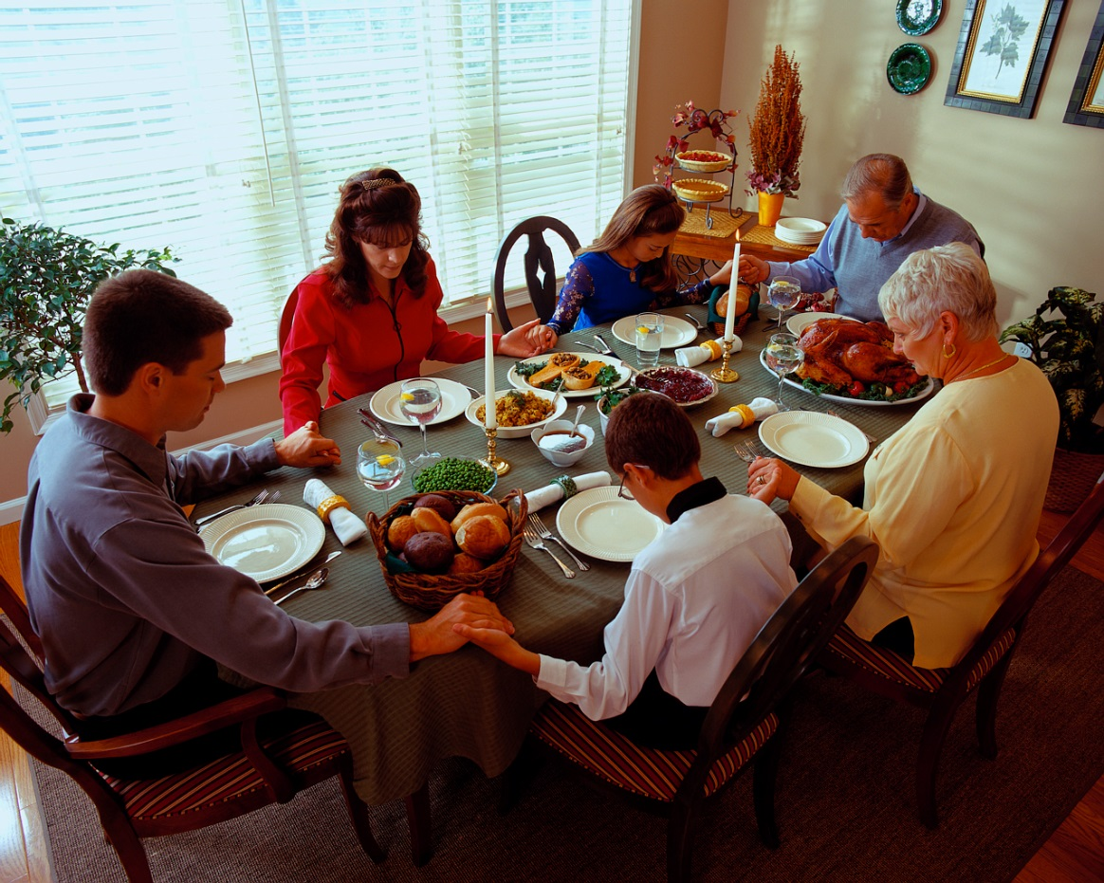
Family
May consist of:
  Spouse
  Children
  Grandparents
  Brothers and sisters
  Step-children
  Other relatives
7
Copyright © Texas Education Agency, 2014. All rights reserved.
Notes:
The function of families are:
meeting the basic needs of family members such as food, shelter, clothing and education
giving emotional control such as helping each other during difficult times
teaching values such as right from wrong and what is most important in life
passing on culture and traditions such as teaching children how to get along with other people and about their family heritage
Who are your family members?

Slide 8

Families Struggling for Work-Life Balance
(click on link)
8
Copyright © Texas Education Agency, 2014. All rights reserved.
Notes:
Click on hyperlink to view video:
Families Struggling for Work-Life Balance
A new study released from the Pew Research Center found 37% of mothers say they want to work fulltime, due, in large part, to the recession and financial insecurity.
http://www.nbcnews.com/video/nightly-news/51186744/#51186744

Slide 9
Time and Energy Management
9
Copyright © Texas Education Agency, 2014. All rights reserved.

Slide 10


Time Saving Techniques
Avoid procrastination
Avoid time wasters
Be flexible
Do it right the first time
Make a To Do list
Practice work simplification
Prevent interruptions
Set goals
Stay organized
Take a break
Use a calendar
Use small amounts of time
Copyright © Texas Education Agency, 2014. All rights reserved.
Notes:
Take advantage of these tips to make time work for you.

Slide 11

Managing Your Energy
Amount changes daily
Identify your peak period
Levels vary with age
Increase levels by:
  Getting plenty of rest
  Eating healthy food
  Exercising regularly
Copyright © Texas Education Agency, 2014. All rights reserved.
Notes:
Understanding when we perform our best and what affects our energy can help us with our work.

Slide 12



Leisure Activities
Hobbies
Vacations
Community activities
Reflection
12
Copyright © Texas Education Agency, 2014. All rights reserved.
Notes:
Leisure time is the time you have free from work and other duties.
This time can include:
Hobbies
building
crafting
drawing
reading
Vacations
visiting family in other cities
visiting amusement parks
Community activities
participating in festivals, concerts or other local activities
Reflection
taking time for yourself by yourself
What is your favorite leisure activity?

Slide 13
Questions?
Copyright © Texas Education Agency, 2014. All rights reserved.

Slide 14
References and Resources
Article:
The Pro & Cons of the Culinary Arts
Becoming a chef isn't just about slicing and dicing; it takes hard work, determination and skill.
http://www.ehow.com/info_7859285_pro-cons-culinary-arts.html
Images:
Microsoft Office Clip Art: Used with permission from Microsoft.
Texbooks:
Kelly-Plate, J., & Eubanks, E. (2004). Today’s teen. New York, NY: Glencoe/McGraw-Hill.
Reynalds, J.S. (2010). Hospitality services: Food & lodging. Tinley Park, IL: Goodheart-Willcox Company.
Video(s):
Families Struggling for Work-Life Balance
A new study released from the Pew Research Center found 37% of mothers say they want to work fulltime, due, in large part, to the recession and financial insecurity.
http://www.nbcnews.com/video/nightly-news/51186744/#51186744
14
Copyright © Texas Education Agency, 2014. All rights reserved.

