Slide 1

Tourism Sales and Distribution
Travel and Tourism Management

Slide 2
Copyright
Copyright © Texas Education Agency, 2015. These Materials are copyrighted © and trademarked ™ as the property of the Texas Education Agency (TEA) and may not be reproduced without the express written permission of TEA, except under the following conditions:
1) Texas public school districts, charter schools, and Education Service Centers may reproduce and use copies of the Materials and Related Materials for the districts’ and schools’ educational use without obtaining permission from TEA.
2) Residents of the state of Texas may reproduce and use copies of the Materials and Related Materials for individual personal use only, without obtaining written permission of TEA.
3) Any portion reproduced must be reproduced in its entirety and remain unedited, unaltered and unchanged in any way.
4) No monetary charge can be made for the reproduced materials or any document containing them; however, a reasonable charge to cover only the cost of reproduction and distribution may be charged.
Private entities or persons located in Texas that are not Texas public school districts, Texas Education Service Centers, or Texas charter schools or any entity, whether public or private, educational or non-educational, located outside the state of Texas MUST obtain written approval from TEA and will be required to enter into a license agreement that may involve the payment of a licensing fee or a royalty.
For information contact: Office of Copyrights, Trademarks, License Agreements, and Royalties, Texas Education Agency, 1701 N. Congress Ave., Austin, TX 78701-1494; phone 512-463-7004; email: copyrights@tea.state.tx.us.
2
Copyright © Texas Education Agency, 2015. All rights reserved.

Slide 3

Tourism
3
Copyright © Texas Education Agency, 2015. All rights reserved.
Notes:
The business of providing hotels, restaurants, entertainment and more for people who are traveling.

Slide 4
Participants
Consumers
Intermediaries
Suppliers
4
Copyright © Texas Education Agency, 2015. All rights reserved.
Notes:
The travel and tourism industry is very large and complex.
All of the participants involved work together to deliver an efficient, profitable and interdependent travel experience for travelers.
To understand how travel is sold and distributed, we first have to look at the participants that are involved in the process.
The participants can be divided into three groups:
Suppliers are companies that create, own and provide the travel products being sold.
Includes: airlines, cruise lines, tour operators, rail lines and even car and RV rental companies
Intermediaries are companies that act as a go-between, linking suppliers with the traveling public.
Example: travel agent
Consumers are anyone that uses travel products.
Includes: consumer are guest, passenger, visitor and customer

Slide 5

Sales
5
Copyright © Texas Education Agency, 2015. All rights reserved.
Notes:
Sales - the total amount of money that a business receives from selling goods or services.

Slide 6
Types of Selling
Transactional Selling
Consultative Selling
Training and experience
Customers need advice
Example – cruises and tours
Simplest
Fewer selling steps
Examples - hamburgers, DVD’s
6
Copyright © Texas Education Agency, 2015. All rights reserved.
Notes:
Next step in understanding the distribution of travel and tourism is to look at how travel is sold.
You need to understand both distribution and selling as they are in direct relation to each other.
There are two main ways of selling travel products: transactional selling and consultative selling.
Transactional selling is the simplest form of sales and requires the least amount of training and the fewest steps in the sales.
Most things you buy today are transactional sales.
Example: hamburgers, DVDs, soda
Consultative selling is a more subtle and skilled form of selling.
It requires knowledge, training and experience and an insight into people’s needs.
Examples: life insurance or financial planning advice
In the travel industry, travel agents and to a less extent, hotel concierges and reservationists use consultative selling.
Consultative selling is required when potential customers need advice and counseling to purchase travel and tours.

Slide 7
Travel Sales
Airlines
Direct
Cruises
Travel agencies
Lodging
Direct
Travel agencies
Travel agencies including online agencies
Cruise lines
Customized tours
Public tours
Tour operators
Consolidators
Cruise lines
Rail companies
Tour operators
Cruise consolidators
Direct
Tour companies
7
Copyright © Texas Education Agency, 2015. All rights reserved.
Notes:
Let’s take a look at the details of how travel is sold and distributed.
Airlines – Most people are surprised to learn that most airline tickets are sold indirect through travel agencies (including online agencies). Of course, they also sell tickets direct as well. Selling through travel agencies may eventually change as most airlines are reducing or eliminating the commission they give to agencies for selling their tickets. Tour operators, rail companies, and cruise line also purchase airline tickets to build a package or bundle services for a complete experience bought all together. Airline consolidators will buy blocks of seats on a flight, often at the last minute, and sell them to the public at discounted prices. Most people think of airlines as being a commodity and bought based on price and flight times available.
Cruise lines – About 80% of all cruise bookings are made through a travel agency as people are reluctant to buy complex and costly experiences on their own. Tour companies offer cruises through their services and often bundle a pre- or post-tour to create value. Cruise consolidators, somewhat like airline consolidators, buy blocks of staterooms and sell them to the public at discounted prices. Land tours for mid-trip port stops are sometimes offered with a cruise package for a complete experience.
Tours are sold direct to the public from tour operators and tours are also offered through travel agencies. Tour packages offered to the public are most often called public tours and will offered with departures on a regular schedule. Tours are also sold to pre-formed groups at a special price and these types of tours are called customized tours or charter tours.

Slide 8
Direct
Travel agencies
Rail
Direct
Travel agencies
Tours
Direct
Public tours
Rentals
Rail passes
Customized tours
Travel agencies
8
Copyright © Texas Education Agency, 2015. All rights reserved.
Notes:
Rentals – Car rentals are sold like other travel suppliers, directly to the public through its own service counters. The largest car rental offices are usually at or near airports. Some are located near hotels. Reselling the older rental cars is a large business for rental car companies. This allows them to keep newer inventory of cars. Car rentals are also sold through travel agencies who sell the rental or uses them to bundle into a travel package.
Rail Travel – Travel by rail is also sold like other travel suppliers, direct and indirect. In the U.S., Amtrak is the corporation that handles most long-distance passenger service. In Canada, the company is called VIA Rail Canada. Many rail systems offer special passes for purchases. This holds true for both local and long-distance rail travel. These are sold for travel during a set number of days and lets people travel unlimited during that time. A well-known pass is called the Eurail pass and offers travel over a large group of countries in Europe on its rail system.
Lodging – About 60% of all lodging is sold directly to the public by hotels and their chains. Another 25% is sold by convention and online travel agencies. Some of the remaining 15% is sold to tour operators and cruise lines which in turn will fold the cost of the hotel into their packages. Most people buy lodging directly because they consider it to be a commodity (most hotels are the same, therefore they buy based on price, location, and availability).

Slide 9
Travel Purchases
Individual travel components
Packaged travel
All-inclusive travel
several components are “bundled” and purchased as one product
all or most components purchased together
each part of the travel is purchased separately
9
Copyright © Texas Education Agency, 2015. All rights reserved.
Notes:
Travel can be purchased in several ways. Three of the main distinctions are:
Travel can be sold by individual and independent components. Airline flights, tours, meals, lodging can all be sold separately.
Travel is often sold as a package where several components are bundled together as one product. For example an airline flight and lodging or stateroom and sometimes meals are sold together. Yet tours, entertainment and rental cars are sold separately if these are wanted by the traveler. Cruises are often sold by this means.
Travel can be sold as all-inclusive where all or most of the travel components are sold together. All-inclusive flights, lodging, meals, activities, entertainment, rentals (if needed) are sold together at one price. There are some resorts that are “All-inclusive” resorts. Travelers know the cost and pay for most or the entire vacation before they leave home.

Slide 10

Distribution
10
Copyright © Texas Education Agency, 2015. All rights reserved.
Notes:
Distribution is the process of making your product available to consumers.

Slide 11
Distribution Path
Suppliers
(airlines, hotels, tour operators, cruise lines, car rental companies)
Indirect Distribution
Direct Distribution
Intermediaries
(travel agencies)
Consumers
(the public)
11
Copyright © Texas Education Agency, 2015. All rights reserved.
Notes:
The flow of travel products (airline ride, cruise and motor home or RV rental) goes from the supplier to the consumer in two main ways, direct and indirect.
A direct distribution path exists when the supplier sells directly to the public. For example, you can call the airline directly to purchase a ticket or even go to their website to buy a ticket. You can call a hotel directly or go to their website to make a reservation. In this direct path, no one else is involved in the transaction except suppliers and consumers.
In the indirect distribution path, the supplier sell to the public through intermediaries. This path is sometimes used when guidance is needed by the consumer. Cruise lines and tour operators prefer to sell through travel agencies because counseling is often required and can take a great deal of time and they typically don’t keep a large reservations staff.
Consumers often like to buy complex travel from travel agencies who are more likely to be impartial and can provide guidance and counseling.

Slide 12
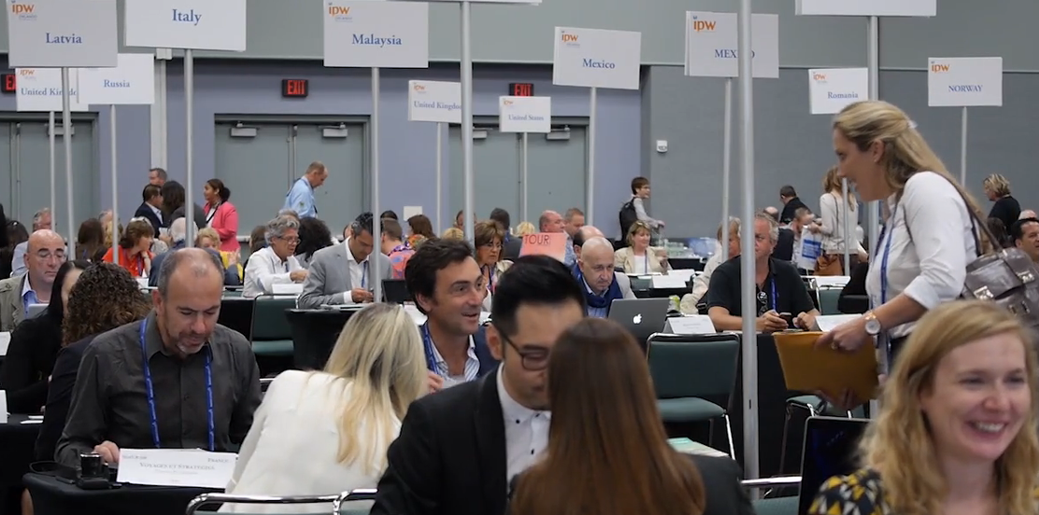
Friday Check-In: Special Episode from IPW Orlando
12
Copyright © Texas Education Agency, 2015. All rights reserved.
Notes:
Click on hyperlink to view video:
Friday Check-In: Special Episode from IPW Orlando
This week's Friday Check-In comes to you from Orlando at the 47th Annual IPW, the nation's premier international travel marketplace. U.S. Travel's President and CEO Roger Dow gives you a recap of the record-breaking event, plus Visit Orlando's George Aguel makes a special appearance to thank sponsors and everyone in attendance.
https://vimeo.com/129785374

Slide 13

13
Copyright © Texas Education Agency, 2015. All rights reserved.
Notes:
What does this quote mean to you?

Slide 14
Let’s Review!
What is tourism?
Who are the participants in the travel and tourism industry?
What are the two types of selling?
Travel sales vary between suppliers – is there a common sales type for the suppliers listed?
What is an all-inclusive travel purchase?
How is travel distributed?
14
Copyright © Texas Education Agency, 2015. All rights reserved.
Notes:
Answers to the questions are found within the slide presentation or may vary with class discussion.

Slide 15

15
Copyright © Texas Education Agency, 2015. All rights reserved.
Notes:
Questions?

Slide 16


References and Resources
Images:
Microsoft Office Clip Art: Used with permission from Microsoft™. (Slide 4)
Shutterstock™ images. Photos obtained with subscription. (Slides 1, 3, 5, 10, 13, 15)
Textbooks:
Mancini, M. (2013). Access: Introduction to travel and tourism. Clifton Park, NY. Cengage Learning.
Reynolds, J. S. & Chase, D. M. (2010). Hospitality services. Tinley-Park, Illinois: The Goodheart-Willcox Company.
Video:
Friday Check-In: Special Episode from IPW Orlando
This week's Friday Check-In comes to you from Orlando at the 47th Annual IPW, the nation's premier international travel marketplace. U.S. Travel's President and CEO Roger Dow gives you a recap of the record-breaking event, plus Visit Orlando's George Aguel makes a special appearance to thank sponsors and everyone in attendance.
https://vimeo.com
16
Copyright © Texas Education Agency, 2015. All rights reserved.

