Slide 1

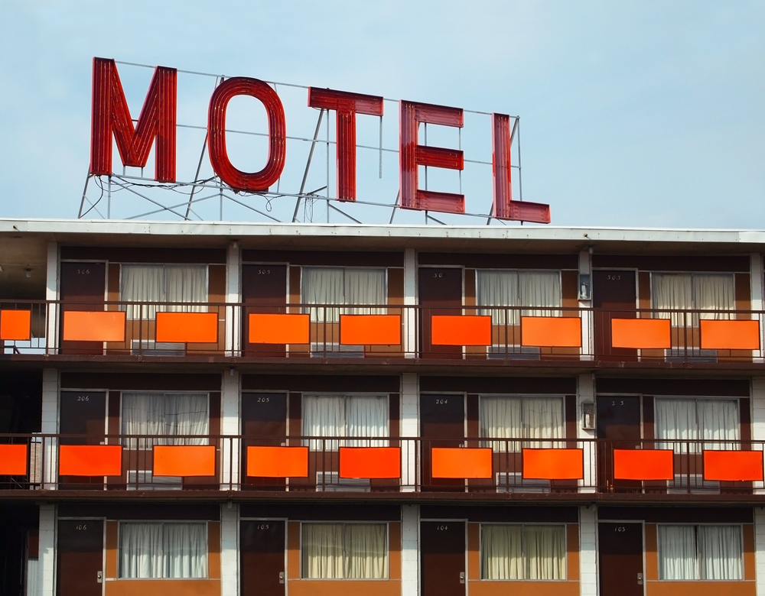
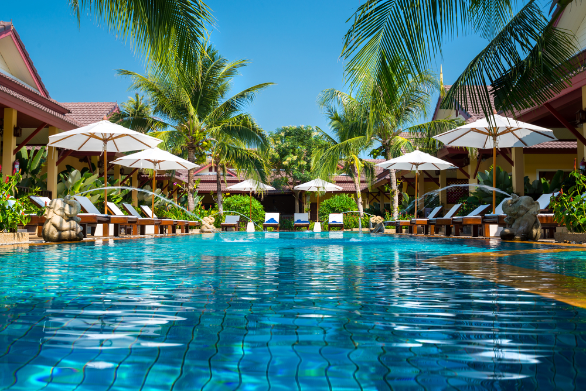
Travel Accommodations
Notes:
Practicum in Hospitality Services

Slide 2
Copyright
Copyright © Texas Education Agency, 2015. These Materials are copyrighted © and trademarked ™ as the property of the Texas Education Agency (TEA) and may not be reproduced without the express written permission of TEA, except under the following conditions:
1) Texas public school districts, charter schools, and Education Service Centers may reproduce and use copies of the Materials and Related Materials for the districts’ and schools’ educational use without obtaining permission from TEA.
2) Residents of the state of Texas may reproduce and use copies of the Materials and Related Materials for individual personal use only, without obtaining written permission of TEA.
3) Any portion reproduced must be reproduced in its entirety and remain unedited, unaltered and unchanged in any way.
4) No monetary charge can be made for the reproduced materials or any document containing them; however, a reasonable charge to cover only the cost of reproduction and distribution may be charged.
Private entities or persons located in Texas that are not Texas public school districts, Texas Education Service Centers, or Texas charter schools or any entity, whether public or private, educational or non-educational, located outside the state of Texas MUST obtain written approval from TEA and will be required to enter into a license agreement that may involve the payment of a licensing fee or a royalty.
For information contact: Office of Copyrights, Trademarks, License Agreements, and Royalties, Texas Education Agency, 1701 N. Congress Ave., Austin, TX 78701-1494; phone 512-463-7004; email: copyrights@tea.state.tx.us.
Copyright © Texas Education Agency, 2014. All rights reserved.
Copyright © Texas Education Agency, 2015. All rights reserved.

Slide 3
Accommodations
Business Organization
Copyright © Texas Education Agency, 2015. All rights reserved.
Notes:
Accommodations are a room, a group of rooms, or a building in which someone may live or stay.
The business organization of travel accommodations consists of single or multiple hotels.

Slide 4

Chain
A business that has more than one location under the same name and the same ownership
Copyright © Texas Education Agency, 2015. All rights reserved.
Notes:
The part of the chain is the brand – the name, logo, tagline or any product that sets it apart from other competitors.

Slide 5
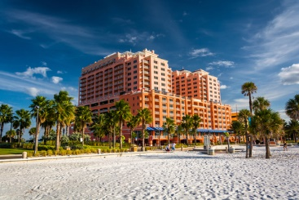
Franchise
The right to do business using the brand and products of another business; also refers to a business that is set up through a franchise agreement
Copyright © Texas Education Agency, 2015. All rights reserved.
Notes:
A franchise is still part of a chain but allows the owner to sell to an outside person for a franchise fee.
The new owner must follow all rules and regulations through the franchise agreement.

Slide 6
Types of Accommodations
Full-Service versus Limited-Service
Copyright © Texas Education Agency, 2015. All rights reserved.

Slide 7
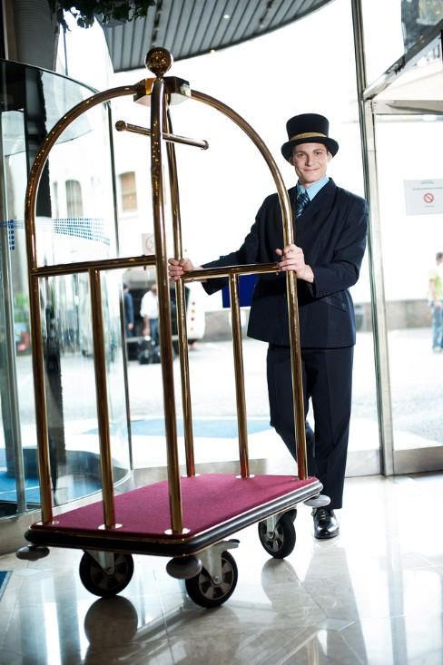

Full-Service Properties
Offers amenities such as restaurant onsite, bell service, room service, concierge services and more
Copyright © Texas Education Agency, 2015. All rights reserved.
Notes:
These hotels are usually very large and have a full range of services.
Can you name some full-service hotels?

Slide 8
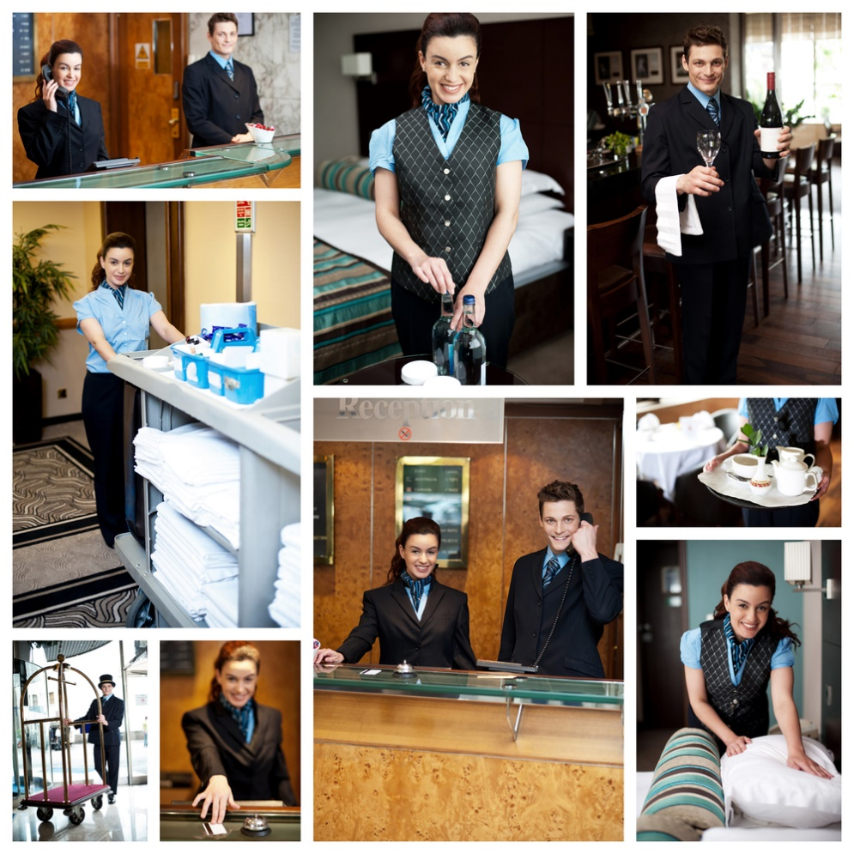
Types of Accommodations
Condominium hotel
Convention hotel
Extended-stay hotel
Luxury hotel
Resort hotel
Copyright © Texas Education Agency, 2015. All rights reserved.
Notes:
Condominium hotels – multiroom apartments with full kitchens usually located in resort areas owned by individuals and operated by a management company.
Convention hotels – designed to provide for the special needs of conventions and trade shows.
Extended-stay hotels – provide kitchen facilities and more than one room for guests staying between five and 29 days.
Luxury hotels – provides the highest level of amenities, room furnishings, public spaces and technology.
Resort hotels – caters to the vacationer or leisure traveler and provides entertainment, recreation and relaxation for vacationers.
Can you name a hotel for each one of these categories?

Slide 9
Limited-Service Properties
Lodging businesses that are smaller, provide fewer services and are less expensive than full-service hotels
Copyright © Texas Education Agency, 2015. All rights reserved.
Notes:
Limited-service properties focus on charging lower prices by providing fewer services.
They may provide only the room and housekeeping.

Slide 10
Types of Accommodations
Budget hotels
Inns
Motels
Copyright © Texas Education Agency, 2015. All rights reserved.
Notes:
Budget hotels – offer the lowest rates and the least service offering a comfortable, clean place to sleep.
Inn - an establishment providing accommodations, food and drink, especially for travelers.
Motel - a roadside hotel designed primarily for motorists, typically having the rooms arranged in a low building with parking directly outside.

Slide 11

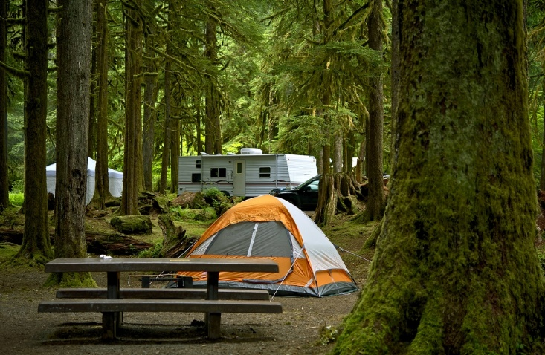
Other Accommodations
Bed-and-Breakfast
Campgrounds
Conference centers
Hostels
Lodges
Copyright © Texas Education Agency, 2015. All rights reserved.
Notes:
Other accommodations may provide less personal service but unique experiences.
Bed-and-Breakfast (B & B’s) – operate in a private home offering one or more guest rooms and a home-cooked breakfast.
Campgrounds – have running water and bathrooms and have areas to set up tents or hook-up a recreational vehicle.
Conference centers – a lodging facility where 60 percent or more of the total occupancy is generated by conferences.
Hostels – are an inexpensive place to stay where sleeping rooms, bathrooms and kitchens are shared. You must bring your own linens and toiletries.
Lodges – provide rooms and housekeeping for guests who want to participate in hunting, skiing, fishing, horseback riding or other outdoor activities.

Slide 12
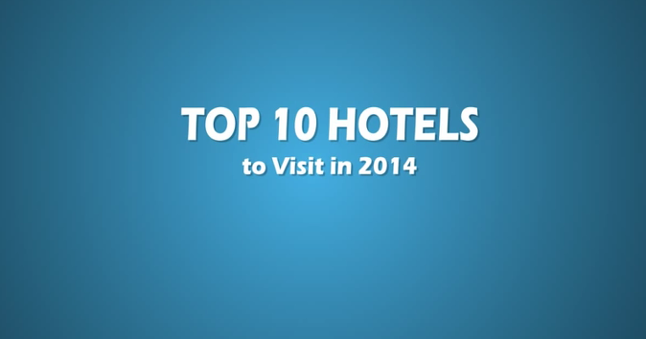
Top 10 Hotels to Visit in the World
(click on image)
Copyright © Texas Education Agency, 2015. All rights reserved.
Notes:
Click on image to view video:
Top 10 Hotels to Visit in the World
10 of the World's Top Hotels to Visit as chosen by HotelsCombined.com, the world's leading hotel price comparison website.
http://youtu.be/jTpp84UBBGI

Slide 13
Where will you Stay?
Copyright © Texas Education Agency, 2015. All rights reserved.

Slide 14

Questions?
Copyright © Texas Education Agency, 2014. All rights reserved.
Copyright © Texas Education Agency, 2015. All rights reserved.

Slide 15
References and Resources
Images:
Microsoft Office Clip Art: Used with permission from Microsoft™. (Slides 9, 10)
Shutterstock™ images. Photos obtained with subscription. (Slides 1, 4, 5, 7, 8, 11, 14)
Textbook:
Reynolds, J. S. (2010). Hospitality services: Food & lodging. Tinley Park, IL: Goodheart-Willcox Company.
YouTube™:
Top 10 Hotels to Visit in the World
10 of the World's Top Hotels to Visit as chosen by HotelsCombined.com, the world's leading hotel price comparison website.
http://youtu.be/jTpp84UBBGI
Copyright © Texas Education Agency, 2014. All rights reserved.
Copyright © Texas Education Agency, 2015. All rights reserved.

