Slide 1
Type 1 Diabetes Investigation

Slide 3

Do you know anyone with Diabetes?
Notes:
Allow students to share.
Do you know if they have Type 1 or Type 2 Diabetes?

Slide 4

What do you already know?
Notes:
In this lesson, we are going to focus on Type 1 Diabetes.

Slide 5

What if You had Type 1 Diabetes?
Notes:
Allow students to share.
How do you think your life would be different if you had Type 1 Diabetes?

Slide 6

Type 1 Diabetes
  What do we need to know?
Notes:
As a parent or educator, what would you need/want to know about the disease?

Slide 7
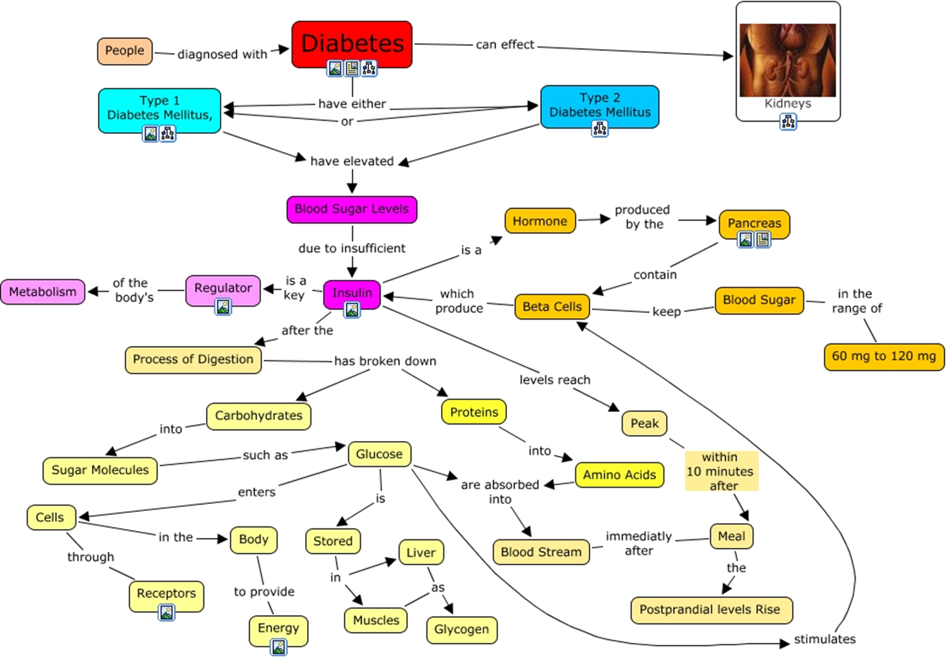
Notes:
What can you tell from this graphic organizer?

Slide 8
Type 1 Diabetes
Notes:
What clues do you get from this slide?

Slide 9
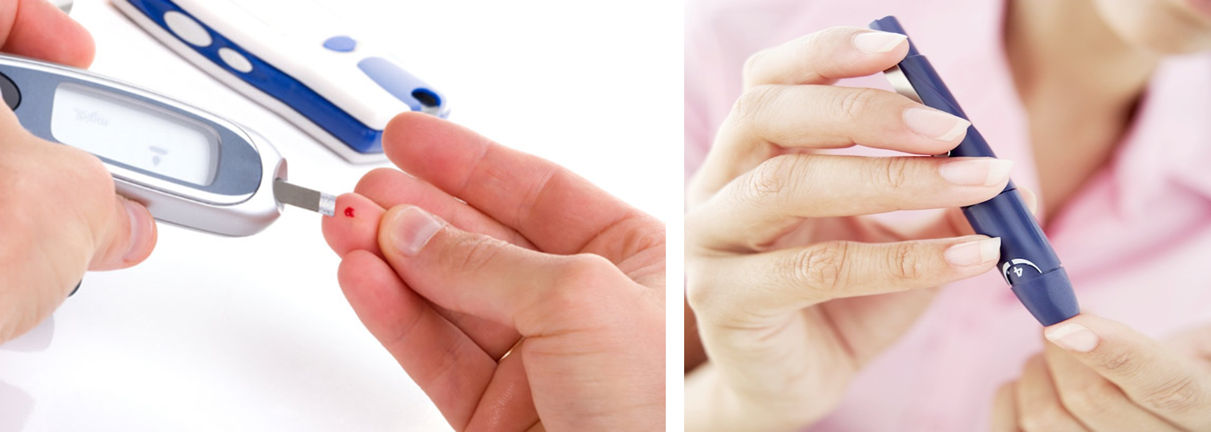
Type 1 Diabetes
Notes:
Does anyone know what is happening in this slide?
Does anyone know the correct name for this tool? Its purpose?

Slide 10
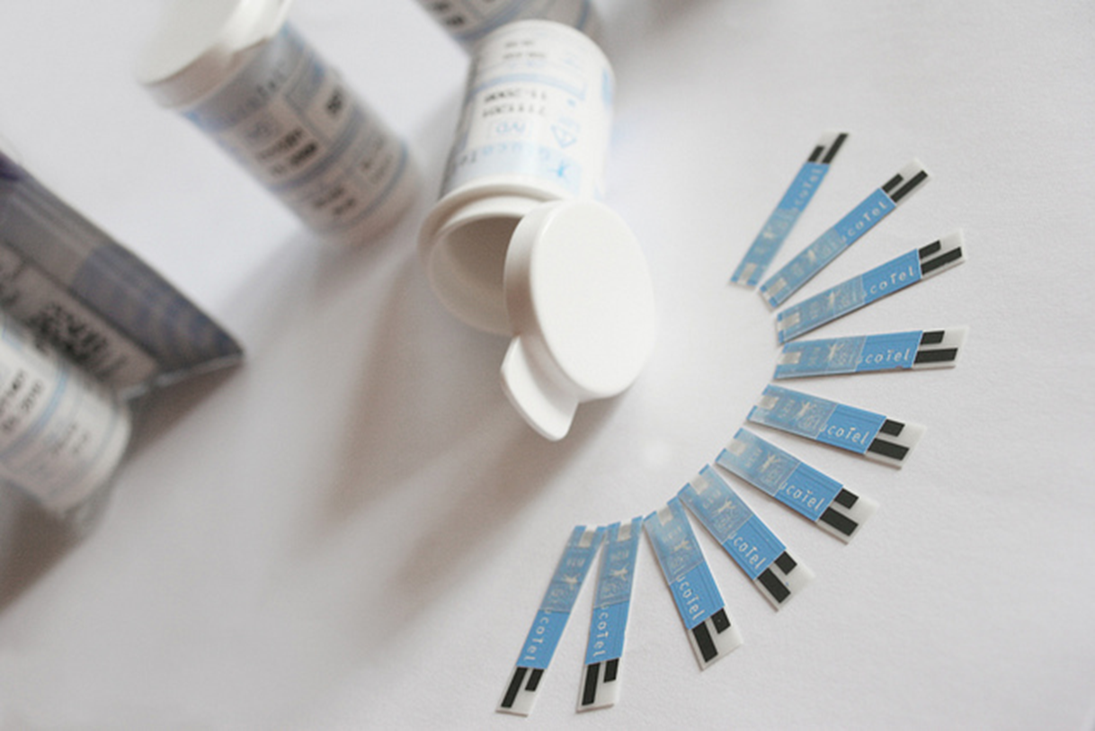
Type 1 Diabetes
Notes:
What does this image show?
What are they used for?

Slide 11
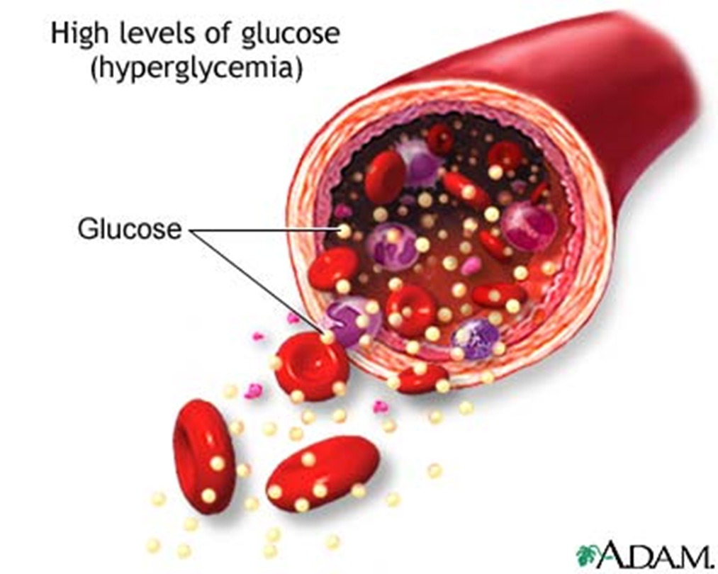
Type 1 Diabetes
Notes:
Think back to your science class, does anyone know another name for glucose?
What is the difference between the prefixes hyper and hypo?
What do you think Hyperglycemia is referring to? Hypoglycemia?

Slide 12
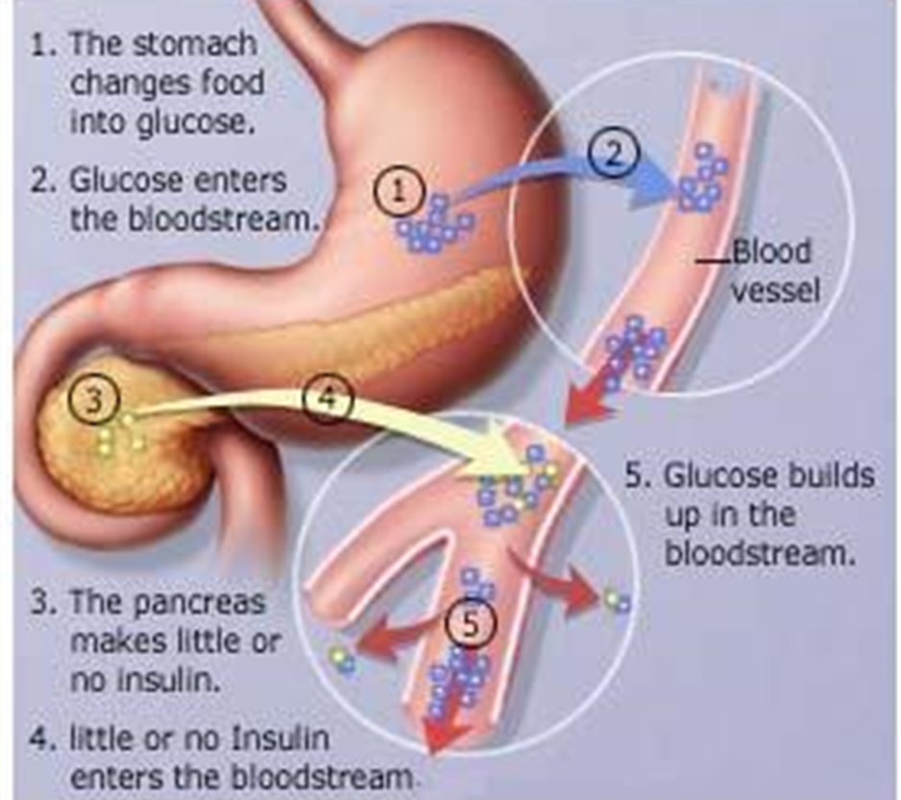
Type 1 Diabetes
Notes:
What are the functions of the stomach?
What about the pancreas? Blood vessels? Bloodstream?
What is insulin?

Slide 13
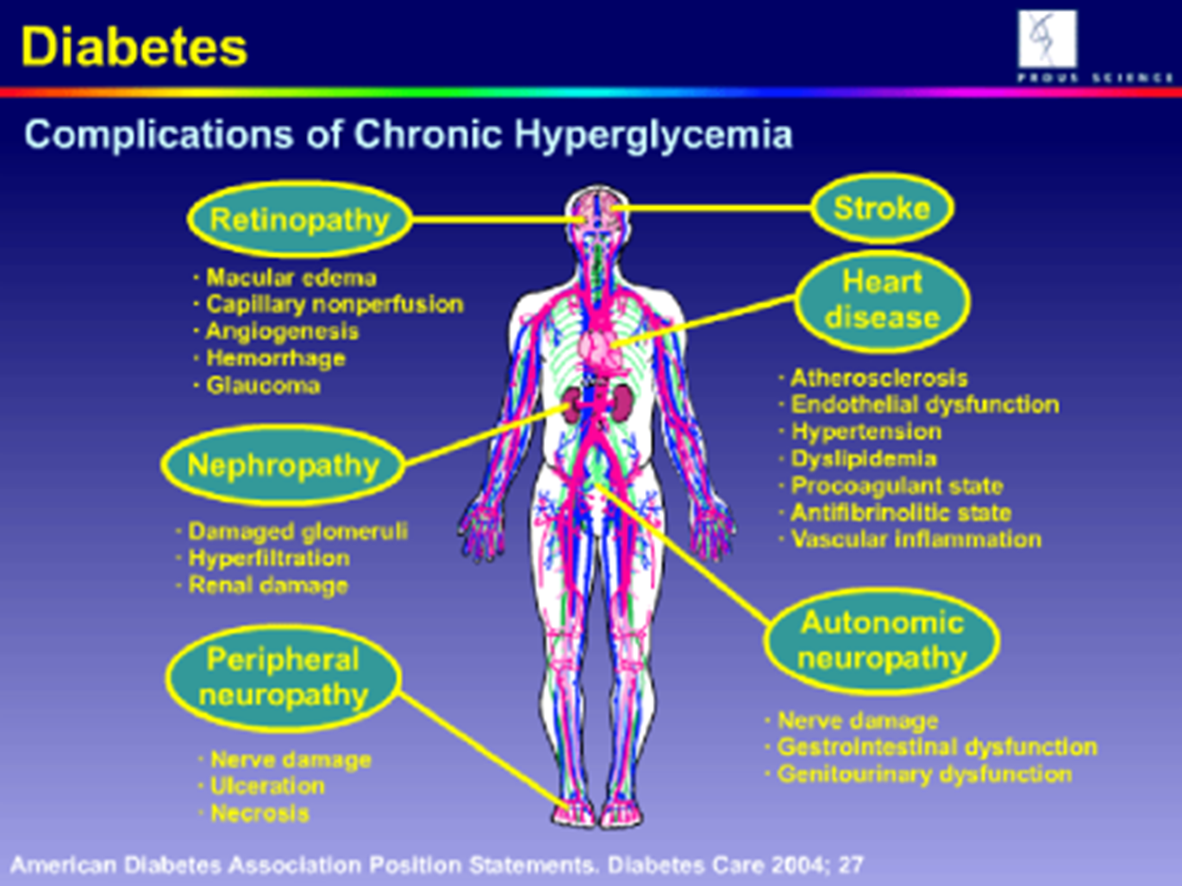
Notes:
What’s another word for complication?

Slide 14

Type 1 Diabetes
Notes:
What type of research do you thinking is being done?

Slide 15
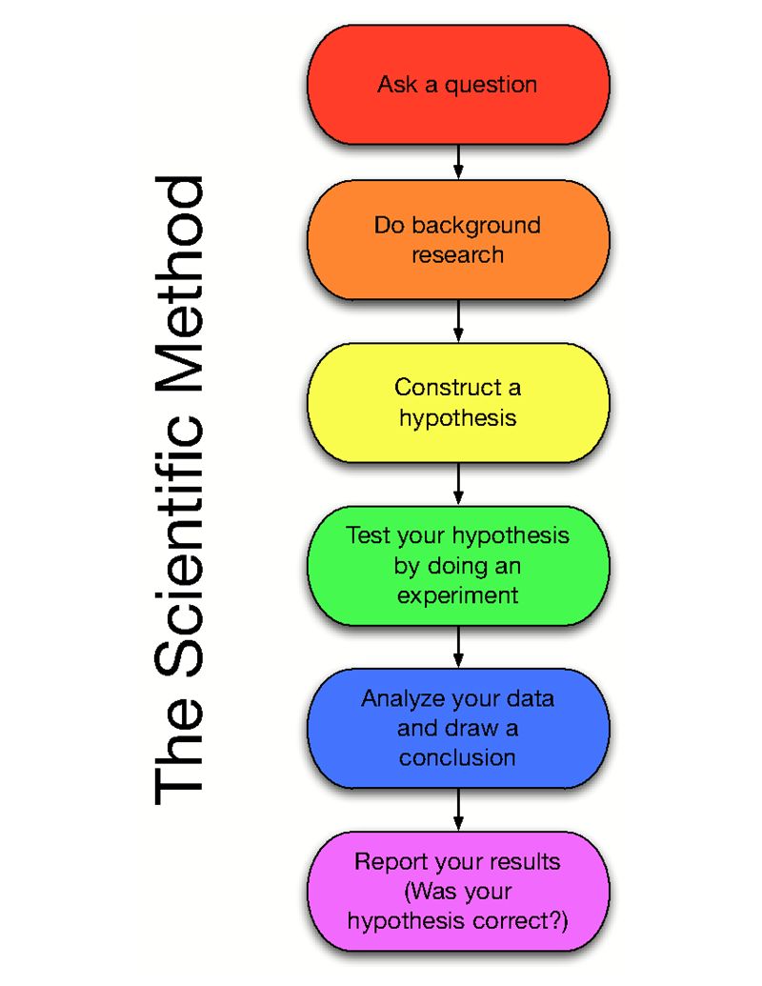

Slide 16
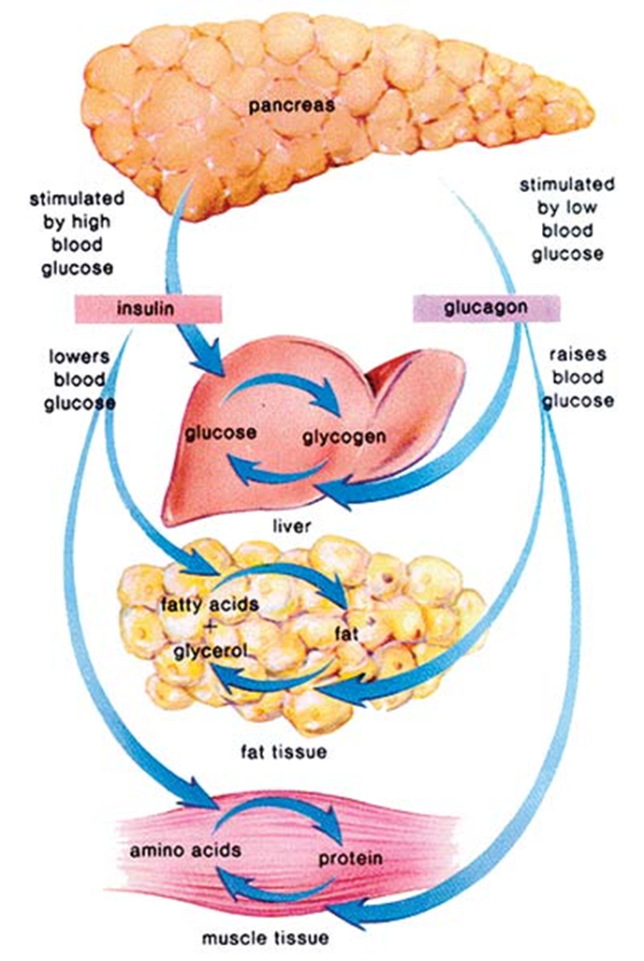

Slide 17
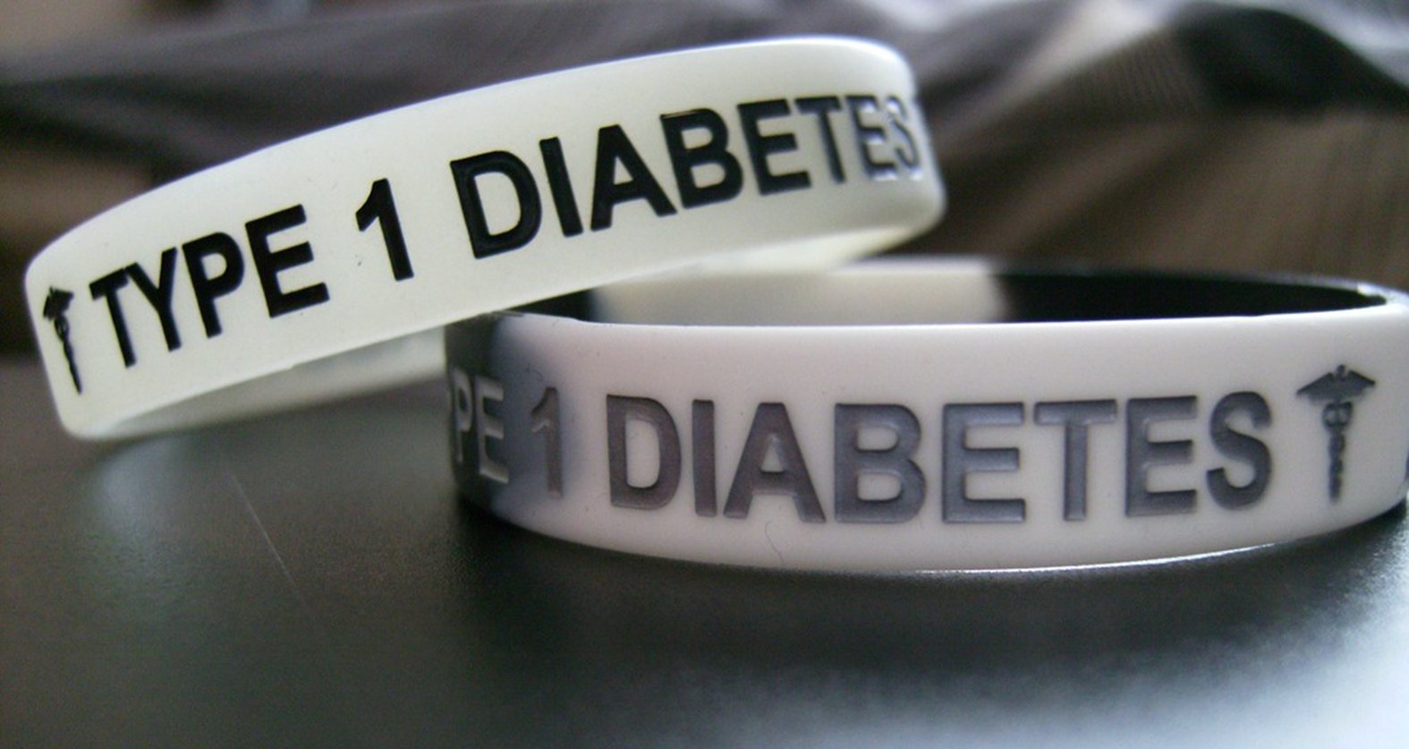
Your Turn
Notes:
Introduce Type 1 Project Options Investigation activity.

Slide 18


Slide 19
  The following video can be viewed at the end of the guided practice section of this lesson.

Slide 20
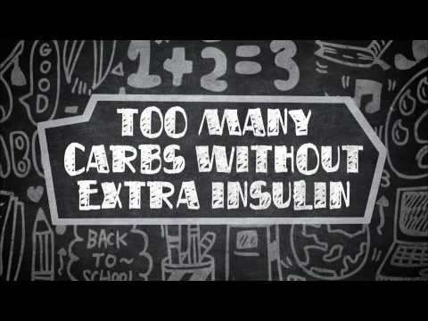

JDRF Type 1 Diabetes 101
  An educational video about type 1 diabetes signs, symptoms, and treatment, featuring kids and teens with the disease
Notes:
Click on image to view video:
JDRF Type 1 Diabetes 101
An educational video about type 1 diabetes signs, symptoms, and treatment, featuring kids and teens with the disease.
http://youtu.be/E0M4oxBtnXo

Slide 21
References and Resources
  Images:
    Microsoft Office Clip Art: Used with permission from Microsoft™. (Slides 1, 3, 4, 5, 6, 7, 8, 9, 10, 11, 12, 13, 14, 15, 16, 17)
    Shutterstock™ images. Photos obtained with subscription. (Slide 18)
  Websites:
    American Diabetes Association
    Articles and resources on diabetes
    http://www.diabetes.org/diabetes-basics/type-1/?loc=util-header_type1
    Juvenile Diabetes Research Foundation (JDRF) Improving Lives Curing Type 1 Diabetes
    The leading global organization funding type 1 diabetes (T1D) research
    http://jdrf.org/

