Slide 1
We Serve – An Introduction to Service Learning
Notes:
How do you serve others? We all serve is some capacity.
You may serve:
by helping a grandparent with chores
as part of an organization that raises funds for the local food bank
as part of a group that in some ways serves local veterans
Sometimes we serve because:
we are required to
we have a passion for helping others
it is our job

Slide 3
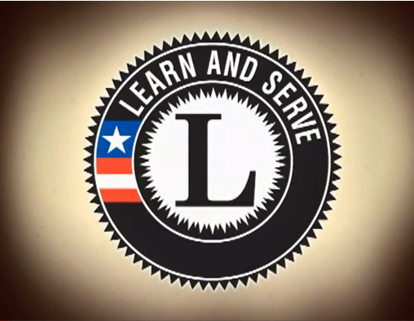
Bring Learning to Life
(click on link)
  Improves academic achievement
  Increases student engagement
  Improves social behavior
  Builds civic skills
  Strengthens community partnerships
Notes:
Bring Learning to Life
This eight-minute video offers insights from teachers, principals, and students who have experienced the benefits of service-learning, and provides an introduction to service-learning as an effective strategy to improve academic achievement, increase student engagement, improve social behavior, build civic skills, and strengthen community partnerships.
http://www.servicelearning.org/lsa/bring_learning/fullvideo.php

Slide 4

Family and Community Service
  Improves family life
  Meets needs
  Provides assistance to others
  Applies skills to help others
Notes:
Often, when we hear the word community service, we think that it is code for someone who has been in trouble and they have to do community service as punishment.
Or, volunteers show up to community wide project sponsored by a city, group, or organization to provide services needed.
But family and community service has a whole other meaning.

Slide 5

How do we serve others?
  By identifying needs
  By forming and implementing plans to meet those needs
  By connecting recipients with those who can help
  By doing
Notes:
We can serve others in a variety of ways. Let’s look at how we can do that.

Slide 6

Who serves families?
  Churches
  Organizations
  Agencies
  Individuals
Notes:
There are many different people that provide service.
Churches – what services do you know they provide?
Organizations – Name some local organizations and how they serve others (Boys and Girls Club, Veterans VFW Auxiliaries, AmeriCorp).
Agencies – What are some agencies that you know about that serve others and what do they do? (Women, Infants, and Children – WIC, Child Protective Services - CPS)
Individuals - How can we serve someone? Give me some examples.

Slide 7

Service as a Career
  Caseworker
  Childcare director
  Child protective service officer
  Clergy
  Counselor
  Daycare teacher
  Financial advisor
  Personal home care aide
  Probation officer
  Therapist
Notes:
There are even people who make a career out of serving others. The list of service careers is extensive but here are a few examples.
Can you think of more examples?
Caseworker - an individual who helps clients with issues such as abusive situations, disability, or financial crisis
Childcare director - manages programs and activities in a variety of care settings
Child protective services officer - law enforcement officer who provides protection to children in domestic situations
Clergy - leads worship services in churches and performs other functions including counseling
Counselor - provides advice to clients who are dealing with various issues and problems
Daycare teacher - delivers instruction and curriculum to children
Financial advisor - assists families with management of financial resources
Personal home care aide -provides assistance to individuals with activities such as meal preparation
Probation officer - assists individual law offenders in abiding to the conditions of their probation
Therapist - someone who diagnoses and treats clients dealing with personal issues
What do you consider the top three characteristics of an individual employed in a service related career?
What service related career is of interest to you? Why?

Slide 8

Questions?

Slide 9
Resources and References
  Images:
    Microsoft Office Clip Art: Used with permission from Microsoft.
  Video:
    Bring Learning to Life
    This eight-minute video offers insights from teachers, principals, and students who have
    experienced the benefits of service-learning, and provides an introduction to service-
    learning as an effective strategy to improve academic achievement, increase student
    engagement, improve social behavior, build civic skills, and strengthen community
    partnerships.
    http://www.servicelearning.org/lsa/bring_learning/fullvideo.php
  Websites:
    Achieve Texas
    An education initiative designed to prepare students for a lifetime of success
    http://www.achievetexas.org

Slide 10
Resources and References
  Websites:
    National Service-Learning Clearinghouse
    America's Most Comprehensive Service-Learning Resource
    http://www.servicelearning.org/success-stories
    The President’s Volunteer Service Award
    A premier volunteer awards program, encouraging United States citizens or lawfully
    admitted permanent residents of the United States through presidential recognition to
    live a life of service
    http://www.presidentialserviceawards.gov/tg/pvsainfo/dspOrderAwards.cfm
    Youth Service America
    25 Years of Youth Changing the World
  http://www.ysa.org

