Slide 1
We are What We Eat – Connecting Food and Health
Nutrition Research

Slide 3
Diet-related illnesses
Eating Disorders
Food Allergies
Medical Conditions
Dietary Guidelines for Americans
Notes:
Do you know someone with Diabetes? High blood pressure? Anorexia Nervosa?
We are going to find out more about health related illnesses in this lesson.

Slide 4
Eating Disorders
A complex illness
Involves harmful attitudes about
body
self
food
Anorexia Nervosa
Bulimia Nervosa
Binge-Eating Disorder
Notes:
Eating disorders are serious and dangerous. People with these disorders often need help to overcome them.

Slide 5
Warning Signs
Refusing to eat
Eating very little
Extreme weight loss
Frequent and intense exercise
Eating secretly
Disappearing after eating
Unhealthy teeth and gums
Loss of menstrual cycle
Use of diet pills or laxatives
Notes:
Eating disorders are emotional illnesses that are dangerous to a person’s health.
Long-term medical problems can result including:
Heart and kidney problems
Breathing difficulties
Digestive troubles
Do you know anyone who has an eating disorder?
How would you try to help them?

Slide 6
Food Allergies
An allergic reaction to a substance in food
Body’s immune system reacts
Even small amounts of food can cause a reaction
May be life-threatening
May cause:
Rash
Swelling of the eyes, lips or throat
Itching
Stomach cramps
Runny nose
Headache
Nausea
Vomiting
Diarrhea
Difficulty breathing
Notes:
Some people are sensitive to foods or substances in food.
Examples:
Lactose intolerance – the inability to adequately digest lactose, the sugar found in milk products
Gluten intolerance - the inability to digest gluten, a protein found in wheat, rye, barley, and perhaps oats
Do you know anyone with a lactose or gluten intolerance? What are their symptoms?

Slide 7
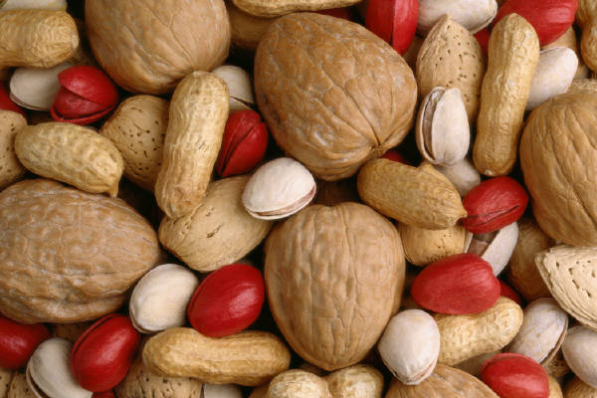
Common Food Allergies
Peanuts
Shellfish
Tree nuts
Fish
Eggs
Soybeans
Wheat
Milk
Solution
Avoid the food
Find a substitution
Notes:
Consult with a physician to diagnose and treat an allergy if you think you have one.
What can happen to someone if they were allergic to peanuts and they ate a peanut butter sandwich?
Discuss consequences.

Slide 8
Medical Conditions
Recurring or taking place over a long period of time
May require:
special eating plans
medical nutrition therapy
Anemia
Diabetes
Coronary heart disease
Goiter
High blood pressure
High cholesterol
Osteoporosis
Rickets
Notes:
Your body can develop problems if you don’t fuel it properly.
Diet can affect health in many ways:
Short-term energy
Body weight
Vitamin deficiencies
Mineral deficiencies
Long-term strain on organs
Disease prevention
Age and appearance

Slide 9
Dietary Guidelines for Americans
Build a healthy plate
Cut back on foods high in solid fats, added sugars and salt
Eat the right amount of calories for you
Be physically active your way
Finding a Balance
(click on link)
Notes:
The Dietary Guidelines for Americans are jointly issued and updated every 5 years by the Department of Agriculture (USDA) and the Department of Health and Human Services (HHS). They provide authoritative advice for Americans ages 2 and older about consuming fewer calories, making informed food choices, and being physically active to attain and maintain a healthy weight, reduce risk of chronic disease, and promote overall health.
Click on hyperlink to view video:
Finding a Balance
The key is FINDING A BALANCE in your lifestyle that includes healthy eating and regular physical activity.
http://www.cdc.gov/CDCTV/FindingBalance/index.html

Slide 10
Questions?

Slide 11
References and Resources
Images:
Microsoft Office Clip Art: Used with permission from Microsoft.
Textbooks:
Duyff. R. L. (2010). Food, nutrition & wellness. Columbus, OH: Glencoe/McGraw-Hill.
Kowtaluk, H. (2010). Food for today. Columbus, OH: Glencoe/McGraw-Hill.
Weixel, S., & Wempen, F. (2010). Food & nutrition for you. Upper Saddle River, NJ: Pearson/Prentice Hall.
Video:
Finding Balance The key is FINDING A BALANCE in your lifestyle that includes healthy eating and regular physical activity. http://www.cdc.gov/CDCTV/FindingBalance/index.html

