Slide 1
Where Shall We Eat?
Culinary Dining Concepts

Slide 3
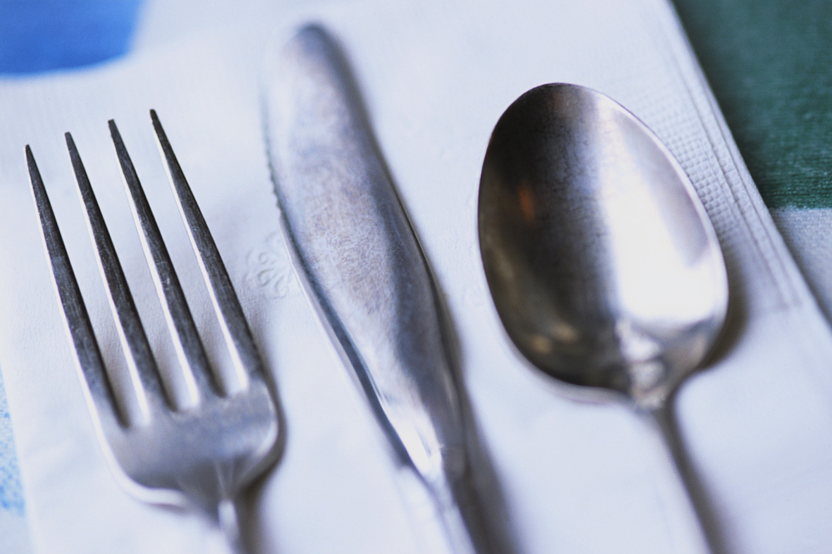
Dining concepts, Service Skills, Types of table settings

Slide 4
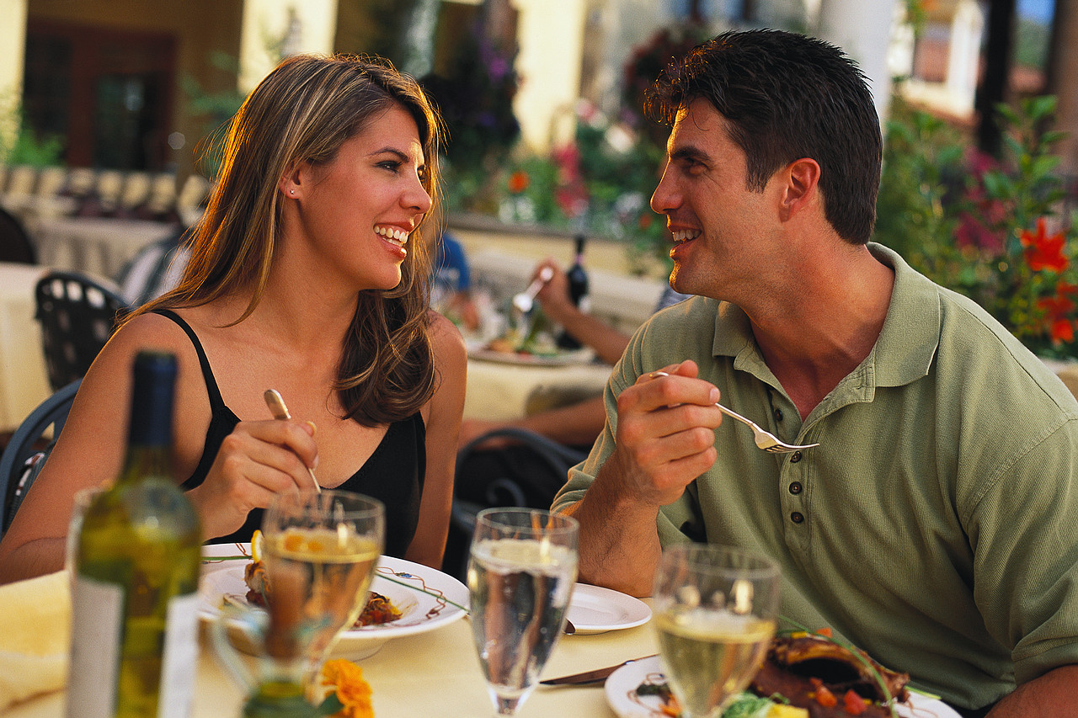
Dining Concepts
  Types
Notes:
There are many eating establishments in our community from which to choose where we would like to eat.
Let’s find out about a few.

Slide 5
Types of Dining
  Bistro
  Buffet
  Cafeteria
  Casual
  Ethnic cuisine
  Fast casual
  Fast food
  Fine dining
  Food Truck
  Theme restaurant
Notes:
Bistro – a small modest restaurant or café
Buffet - a restaurant that has meals consisting of several dishes from which guests serve themselves
Cafeteria - a restaurant or dining room in a school or a business in which customers serve themselves or are served from a counter and pay before eating
Casual - offer table side service, non-disposable dishes, while still keeping the menu moderately priced
Ethnic cuisine – a restaurant that is built around a specific type of food, such as Mexican, Chinese, Indian or Italian, to name a few. The menu, décor and restaurant name should all reflect the ethnic cuisine.
Fast casual - offer disposable dishes and flatware, but their food tends to be presented as more upscale, such as gourmet breads and organic ingredients
Fast food – can be prepared quickly and easily and is sold in restaurants and snack bars as a quick meal or to be taken out
Fine dining - offers patrons the finest in food, service and atmosphere and is also the highest priced type of restaurant you can operate
Food truck - like a restaurant on wheels, it has several distinct advantages over a traditional eat-in restaurant since it can go to the customers. It has low overhead, compared to a restaurant, and requires far less staff.
Theme restaurants - the concept of the restaurant takes priority over everything else, influencing the architecture, food, music, and overall 'feel' of the restaurant
Can you think of any other types?

Slide 6
Service
  Meal
  Fine dining
Notes:
Service is a style of serving meals to match dining establishment’s customers and goals.

Slide 7
Meal Service
  Banquette
  Booth
  Buffet
  Butler
  Classical French
  Family style
  Modern American plated
  Russian
Notes:
Banquette - a type of seating arrangement in which customers are seated facing the server, with their backs against a wall
Booth - the table rests against, or is attached to, a wall and customers are served from a single focal point
Buffet - all the food is attractively displayed on a table for customers to see and choose what they want and serve themselves
Butler - the server carries the prepared food on a silver tray to standing or seated customers and customers serve themselves from the trays
Classical French - the most elegant and elaborate style as some foods are fully or partially prepared tableside in full view of the customer
Family-style - is used in a casual-dining atmosphere where customers serve themselves and pass the food around the table just like home
Modern American plated - the most popular because it requires fewer and less extensively-trained staff where the food is completely prepared, portioned, plated and garnished in the kitchen
Russian - another elegant, formal service that is used internationally where each course is completely prepared, cooked, portioned and garnished in the kitchen and then placed on a service plate or platters
Have students give you some examples of each of these with restaurants in your area or places they have visited.

Slide 8
Fine dining service
  Host
    Greet and welcome guest
    Make small conversation during seating
    Escort guests to table
    Pull chair for female guest
    Present food menu
  Server
    Introduce yourself
    Smile
    Mention chef’s daily special
    Remove extra settings (if necessary)
    Take guests’ drink orders
    Upsell
Notes:
As customers are waited on, there is a sequence in which customers are generally served.
These steps may be done by different people such as a host/hostess and wait staff.
The sequence may vary depending on the type of restaurant.

Slide 9
Table service
  Serve drink
  Take meal order and repeat
  Write order on ticket correctly
  Order food in kitchen
  Deliver food in order
    Soup
    Salad
    Entree
  Serve bread
  Serve from the left
  Take from the right
  Remove each course before next course
  Check with customer
  Refill beverage
  Crumb table if needed
Notes:
The server provides the best quality service to the customer at a dining establishment.

Slide 10
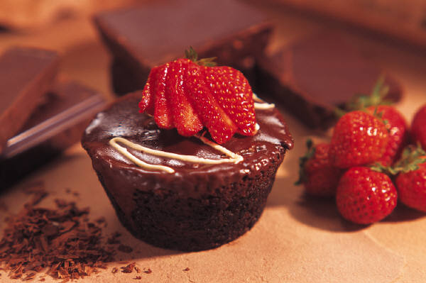
Table service - desserts
  Present dessert menu
  Upsell coffee and dessert
  Serve dessert
  Present check
  Thank customer
  Clear table

Slide 11
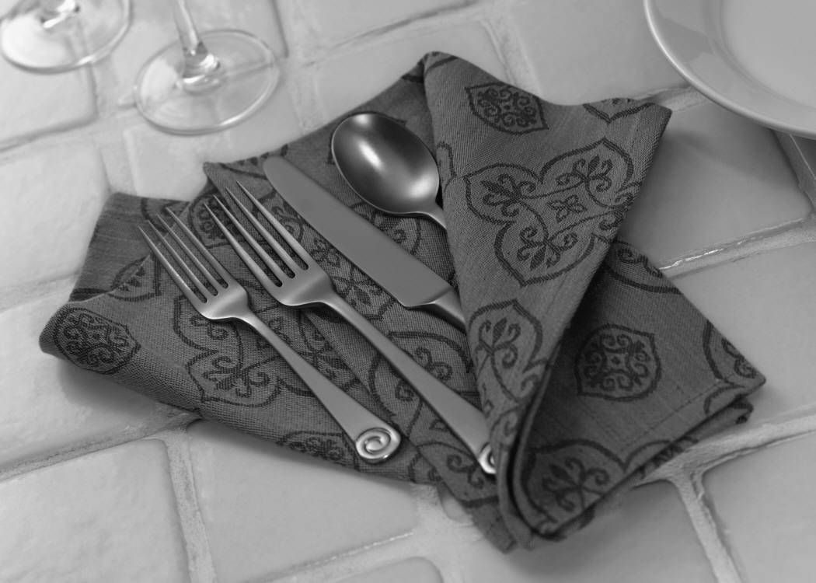
Table settings
  Table
  Napkins
  Place settings

Slide 12
Linens
  Table
    Table cloth or placemat
    Centerpiece
    Setting a Formal Table Setting
    (click on link)
  Napkins
    Clean
    Crisp folds
    Should stand straight
Notes:
All linens should be clean, pressed and free from stains.
Choose an appropriate centerpiece for your table.
View Good Housekeeping video:
Setting a Formal Table Setting
The basics to setting a formal table.
http://youtu.be/qKSHmmNk_5Y

Slide 13
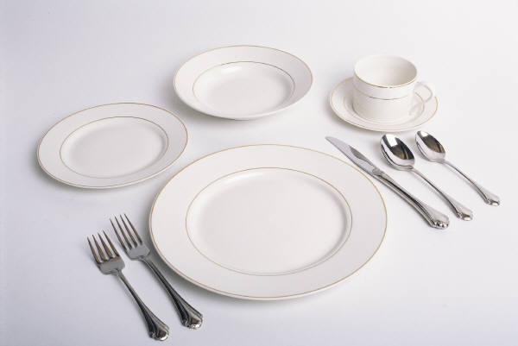
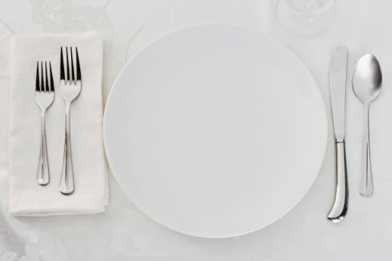
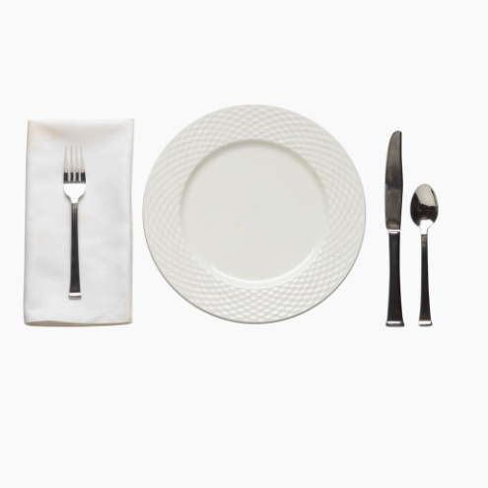
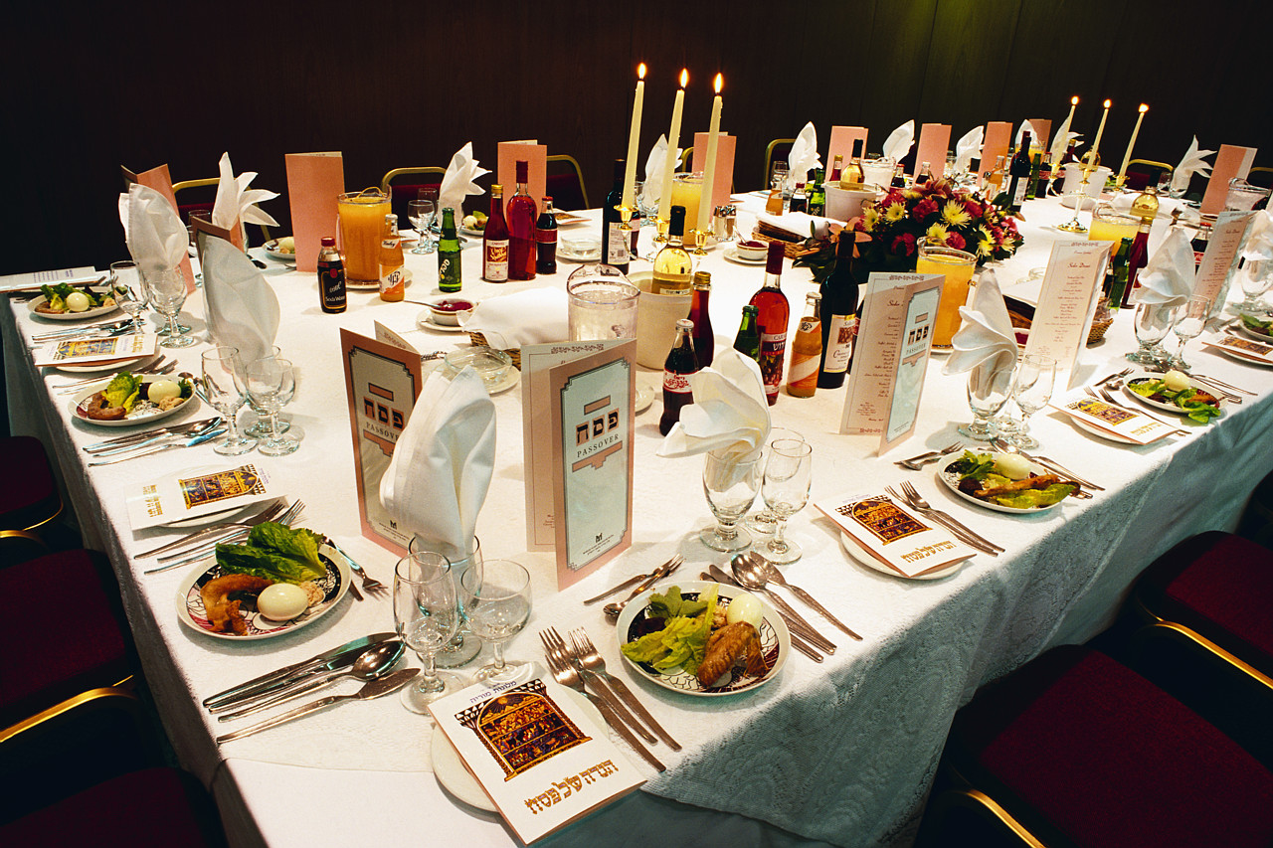
Place Settings
  Breakfast
  Lunch
  Dinner
  Formal Dinner
Notes:
To center each place setting, first place the napkin. Set fork on the left side of the plate and the knives and spoons on the right side.
Always set knives with the cutting edge toward the center of the place setting.
Place flatware one inch from the edge of the placemat or table.
Place all flatware from the outside in, following the order of use.
Place the bread-and-butter plate on the left, above the fork(s).
Place the water glass above the tip of the dinner knife.
Preset coffee cups to the right of the knives and spoons, with handles at the 4 o’clock position.

Slide 14

Questions?
  Abc
  Abc

Slide 15
References and Resources
  Images:
    Microsoft Office Clip Art: Used with permission from Microsoft.
  Textbook(s):
    Culinary essentials. (2010). Woodland Hills, CA: Glencoe/McGraw Hill.
    Draz, J., and Koetke, C. (2010). The culinary professional. Tinley Park, IL: Goofheart-Willcox Company.
    Foundations of restaurant management & culinary arts: Level one. (2011). Boston, MA: Prentice Hall.
  Website:
    SkillsUSA
    Restaurant Service
    http://www.skillsusa.org/compete/contests.shtml
  YouTube™:
    Setting a Formal Table Setting
    The basics to setting a formal table.
    http://youtu.be/qKSHmmNk_5Y

