Slide 1
Who’s Protecting Our Children?
Human Growth and Development

Slide 3
Terms
Abuse: Includes physical abuse, neglect, emotional abuse and sexual abuse
Child Protective Services (CPS): A government agency that investigates reports of abuse and neglect of children
Emotional and verbal abuse: Rejecting children, blaming them, or constantly scolding them, particularly for problems beyond their control
Mandated reporter: A person who is required by law to report maltreatment

Slide 4
Terms
Neglect: Failing to provide for a child's basic needs, including food, water, a place to live, love and attention
Physical abuse: Intentionally causing an injury to a child
Sexual abuse: Includes any inappropriate sexual behavior with a child, including touching or taking photographs

Slide 5
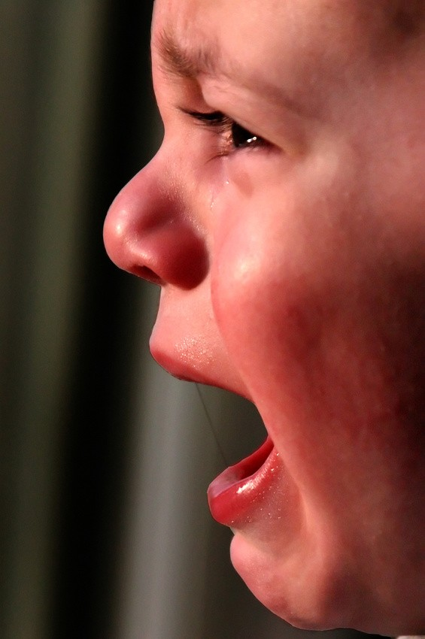
Child Abuse

Slide 6

Types of Child Abuse
Physical
Neglect
Sexual
Emotional

Slide 7
Physical Abuse
Physical signs
    Unexplained
      Bruises or welts
      Burns
      Fractures or dislocations
      Bald patches on scalp
Behavioral signs
    Student states he/she “deserves” punishment
    Fearful when others cry
    Behavioral extremes (aggressive, withdrawn)
    Frightened of parents or caretakers
    Afraid to go home
    Child reports injury by parents or caretakers
    Needy for affection
    Manipulative behaviors to get attention
    Unable to focus – daydreaming
    Self abusive behavior or lack of concern for personal safety
    Wary of adult contact

Slide 8
Neglect
Physical signs
    Not meeting basic needs (food, shelter, clothing)
    Failure to thrive (underweight, small for age)
    Persistent hunger
    Poor hygiene
    Inappropriate dress for season or weather
    Consistent lack of supervision and emotional care
    Unattended physical problems or medical needs
    Abandonment

Slide 9
Neglect
Behavioral signs
    Begging or stealing food
    Early arrival or departure from school
    Frequent visits to the school nurse
    Difficulty with vision or hearing
    Poor coordination
    Often tired or falling asleep in class
    Takes on adult roles and responsibilities
    Substance abuse
    Acting out behavior
    Educational failure
    Verbalizing lack of caretaking

Slide 10
Sexual Abuse
Physical signs
    Difficulty walking or sitting
    Torn, stained, or bloody undergarments
    Pain, swelling, or itching in genital area
    Pain when urinating
    Vaginal or penile discharge
    Bruises, bleeding, or tears around the genital area
    Sexually transmitted diseases

Slide 11
Sexual Abuse
Behavioral signs
    Unwilling to change for gym or participate in PE activities
    Sexual behavior or knowledge inappropriate to child’s age
    Sexual acting out on younger children
    Poor peer relations
    Delinquent or runaway behavior
    Report of sexual assault
    Drastic change in school performance

Slide 12
Sexual Abuse
Behavioral signs
    Sleep disorders/nightmares
    Eating disorders
    Aggression
    Withdrawal
    Fantasy
    Self abuse
    Substance abuse
    Repetitive behavior (hand washing, pacing, rocking)

Slide 13
Emotional Abuse
Physical signs
    Speech disorders
      Stuttering
      Baby talk
      Unresponsive
    Failure to thrive (underweight, small for age)
    Hyperactivity
Behavioral signs
    Learning disabilities
    Habits of sucking, biting, rocking
    Sleep disorders
    Poor social skills
    Extreme reactions to common events
    Unusually fearful
    Overly compliant behaviors (unable to set limits)
    Suicidal thoughts or actions
    Self abuse
    Difficulty following rules or directions
    Child expects to fail so does not try

Slide 14
Reporting Child Abuse

Slide 15
Mandated Reporters
Teachers
Doctors
Nurses
Social workers
Counselors
Psychologists

Slide 16
Reporting Child Abuse in Texas
Information to have on hand before reporting child abuse (if known):
Name, age, address of the child
Your name and contact information
A brief description of the situation and child
Current injuries, medical problems or behavioral problems
Parents’ names and names of siblings in the home
Names of relatives in or outside the home
Explain how you know about the situation
Texas Department of Family and Protective Services
1-800-252-5400
    The Abuse Hotline is toll-free and open 24 hours a day, 7 days a week
TxAbuseHotline.org
    Report cases online and get a response within 24 hours

Slide 17
Responding to a child who is abused or neglected

Slide 18
Responding to Abused Children
Remain calm
Believe the student
Listen without passing judgment
Tell the student you are glad he/she told someone
Assure the student that abuse is not his/her fault
Do what you can to make sure the student is safe from further abuse
Do not investigate the case yourself

Slide 19
Treatment for Abused Children

Slide 20
Treatment
Protection from further harm
Improve family communications
Encourage healthy friendships
Teaching children to care for themselves and make healthy choices
Help children to have realistic expectations of parents who may have problems
Provide a safe place to release anger, disappointment and sadness

Slide 21
Preventing Child Abuse

Slide 22

Prevention
Education and knowledge can prevent child abuse.

Slide 23
Resources for Abused Children

Slide 24
Resources and References
Childhelp
National Child Abuse Statistics
This website gives informative information on child abuse statistics in America.
http://www.childhelp.org/pages/statistics#stats-sources
HealthyChildren.org
Safety and prevention: What to know about child abuse
The American Academy of Pediatrics gives valuable information and the signs and symptoms of child abuse.
http://www.healthychildren.org/English/safety-prevention/at- home/Pages/What-to-Know-about-Child-Abuse.aspx

Slide 25
Resources and References
Child Welfare Information Gateway
National Child Abuse Prevention Awareness Month
Information on child abuse prevention awareness month and activities to do for each day of the month.
http://www.childwelfare.gov/preventing/preventionmonth/
Texas Department of Family and Protective Services Texas Child Protective Services (CPS)
This website gives an overview of CPS and specific information its responsibilities.
http://www.dfps.state.tx.us/child_protection/

Slide 26
Resources and References
Images:
Microsoft Office Clip Art: Used with permission from Microsoft. Textbooks:
    Brisbane, H. (2010). The developing child. Columbus, OH: Glencoe/McGraw-Hill.
    Morrison, G. (2012). Early childhood education today. Upper Saddle River, NJ: Pearson Education, Inc.

