Slide 1
Working Cooperatively in Social Systems
Practicum in Agriculture, Food, and Natural Resources

Slide 3
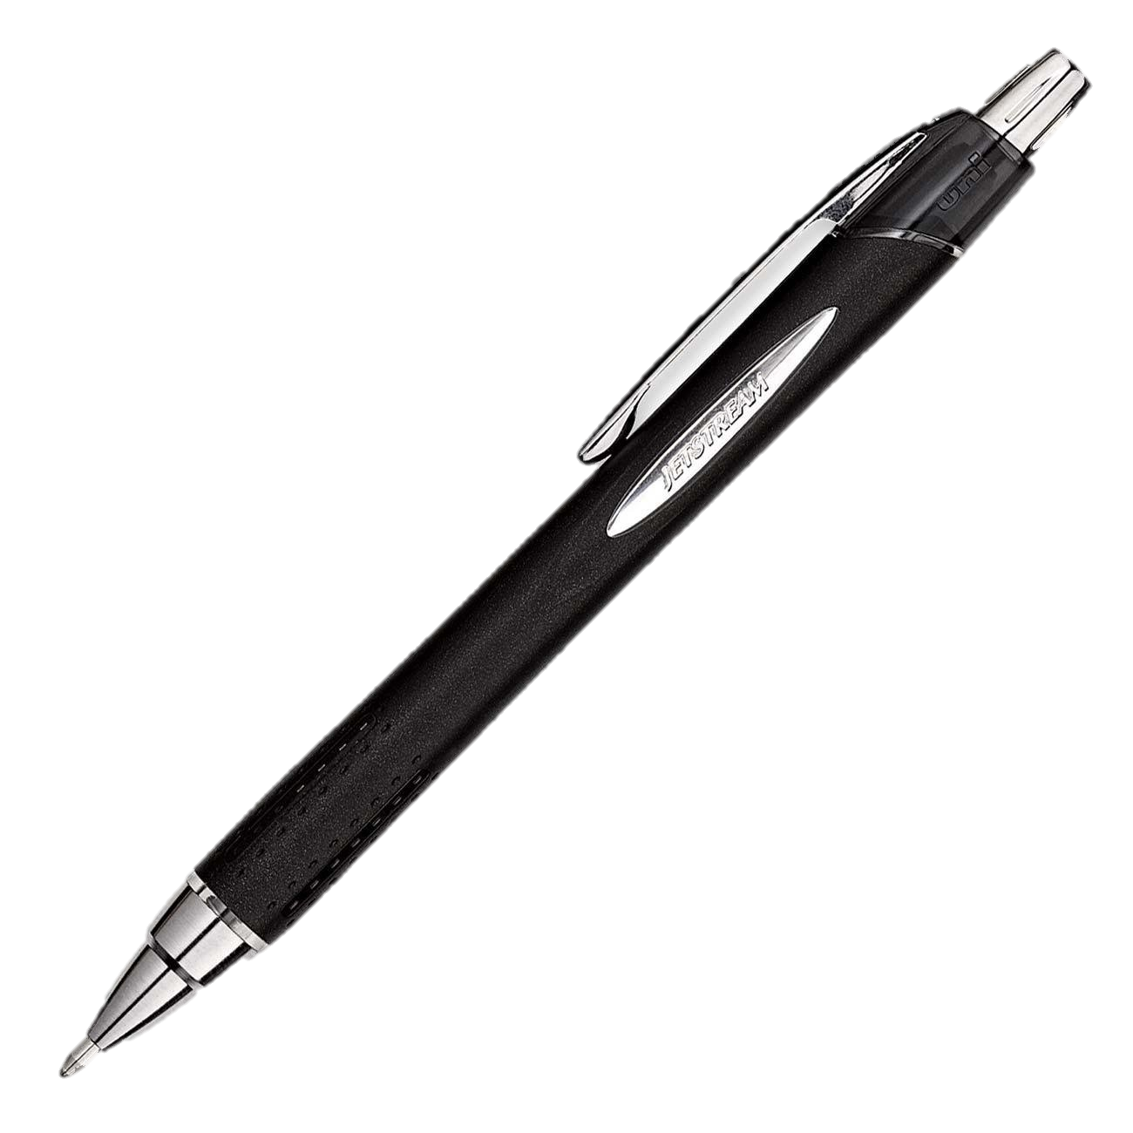
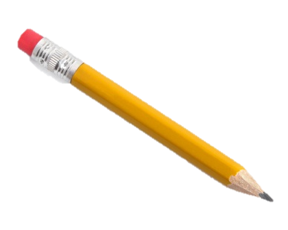
Systems of Operation in Agriculture, Food, and Natural Resources

Slide 4
Today we will…
Explain the purpose and benefits of systems in agriculture, food, and natural resources
Identify multiple examples over systems of organization
Create a flowchart defining the systems of organization

Slide 5
Understanding Systems
Agriculture / agribusiness is a very complex system.
Factors that determine commodity prices include:
Weather
Investments
Consumer preferences
Imports
Tariffs
Foreign trade

Slide 6
Understanding Systems
Factors that can determine input costs are:
Availability
Stock prices
Competition
Size of the manufacturer
Discounts
Component costs
Changes or variations in any one of these factors can impact the entire system.

Slide 7
Example of a Commodity Production
Cropping systems is just one of many complex sets of relationships in commodity production.

Slide 8
Questions to Consider When Selecting a Cropping System
What commodity do I plant?
What are the moisture requirements?
When do I plant?
Is day length a significant factor?
What variety do I plant?
Will growth regulators be effective?
What is the variety’s maturity date?
Do I have the right harvest equipment?
Is my soil type suited for this variety?
What is the time window for harvest?

Slide 9
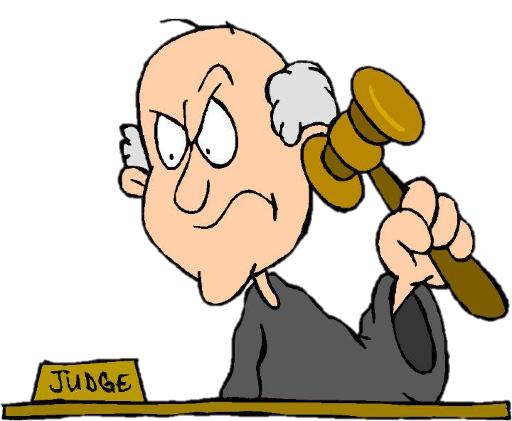
Examples of Systems in Our Society
Legal system
Criminal justice system
Political system
Educational system
Distribution system

Slide 10
School Administrative System
Your school may have a highly organized administrative system.
A principal may have one or more assistant principals to assist with day-to-day operations.
Each assistant principal may perform several functions.

Slide 11
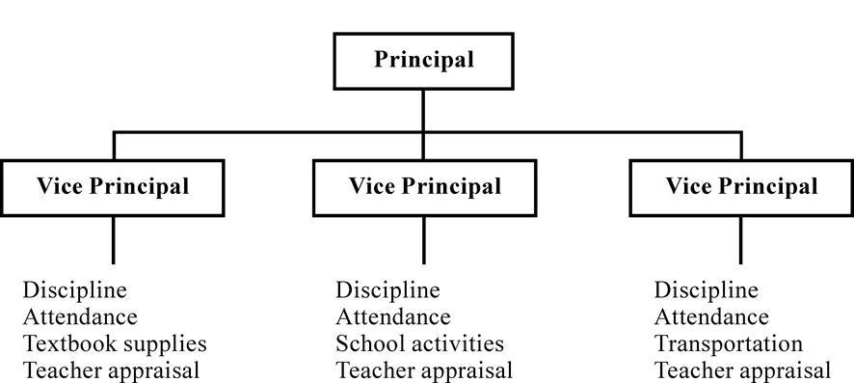
Example of a School Flow Chart

Slide 12
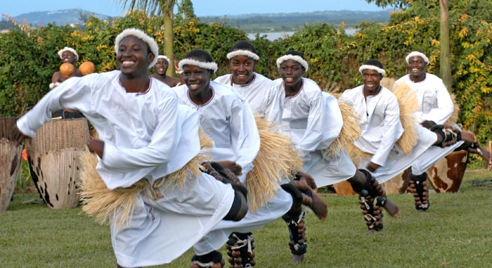
Social Systems
Deals with people and cultures

Slide 13
Organizational Systems
Deals with specific working groups of people

Slide 14
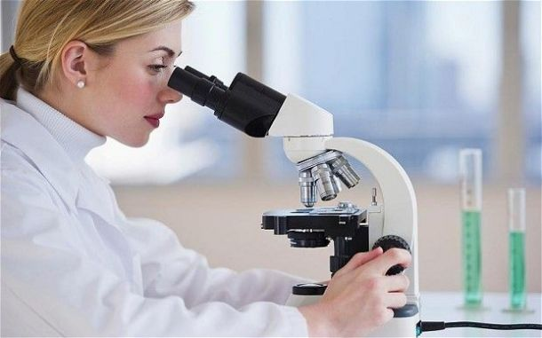
Technological Systems
Apply scientific knowledge to perform work

Slide 15
How Systems Work
System dynamics is a method of studying the world around us as a group of independent parts comprising a whole.
Systems come in different sizes, based on factors such as the number and type of functions to be performed.

Slide 16
Common Factor Among Systems
One common factor common to most systems is the assignment of tasks or division of labor:
Who does what, when, and where, and who else is involved.

Slide 17
Common Characteristics of Organizational Systems
Systems have a purpose
All sub-systems must be present and functioning for optimum system performance
The order is which the sub-systems are arranged affects performance
Systems try to maintain stability through a feedback process

Slide 18
Common Characteristics of Organizational Systems
A larger system is often called an organization, while smaller systems are known as teams, clubs, or groups.
Each system has its own leader and method of operation, complete with procedures and rules or “codes.”

Slide 19
Impact of Systems
As the world of agriculture continues to change, what is needed to be successful in an ag-related career also changes.
To be an effective employee, you need to understand the impact of systems – seeing specific tasks as only a small part of the overall job – and know where you impact the system.

Slide 20
Operating Effectively Within Systems

Slide 21
Operating Effectively Within Systems
Some tasks require you to work alone, while other assignments require some teamwork.
Work teams can be used for product development, troubleshooting, and other major tasks.

Slide 22
Concepts Particular to the Systems Perspective
Making suggestion to modify existing systems, to improve products or services;
Developing new or alternative systems;
Making suggestions to improve the workings of the system or organization;
Recommending alternative systems based on appropriate input from others;
Understanding how systems work;

Slide 23
Concepts Particular to the Systems Perspective
Respond to the demands of the system;
Gathering information about the functions of the system;
Detecting changes from the system’s intended purpose
Changing the system to improve functions and ensure product quality; and
Troubleshooting the system

Slide 24
Committees
As you learn to operate within the different systems, it is vital to know how the structure of a particular system relates to the goals and purposes of the organizations
For example, FFA committees are a major part of organizing chapter activities.

Slide 25
FFA Committees
The FFA committee system focuses on major activities by identifying standard areas that are important to members across the country.
Participating in a variety of activities makes FFA chapters successful, and it showcases chapter members and programs.

Slide 26
FFA Standard Committees
Finance / Economics
Human Resources
SAE
Recruitment
Support Groups
Public Relations
Agriculture Career Skills
Leadership
Scholarship
Citizenship
Environmental
Agricultural Awareness
Healthy Lifestyle

Slide 27
Example of a Situation or Input that Can Impact Your System
As a committee member, you learn how your committee works, and how your work impacts the entire chapter.
For example, if the Public Relations committee decides to host a breakfast for the teachers at your school, this decision can impact the Finance / Economics, Support Groups, and Agricultural Awareness committees.

Slide 28
Example of a Situation or Input that Can Impact Your System
This is a list of questions that the Public Relations committee should consider while planning the breakfast:
What is the best way to publicize the breakfast?
How much will the breakfast cost? Can the chapter afford the breakfast? How do we compare cost per plate vs. cost per menu item? Prepared on-site or catered? Catering vs. volunteer cooks?

Slide 29
Example of a Situation or Input that Can Impact Your System
How can we involve more teachers and support organizations? Can we partner with other groups to put on the breakfast? Pork producers; local grocers; Young Farmers; dairy industry; bakers; restaurants; extension workers; safety groups; alumni members; Food, Land, & People volunteers; and Agrifood Masters?

Slide 30
Example of a Situation or Input that Can Impact Your System
To be able to respond effectively to the demands of the system, you must also learn where to secure information and resources, and learn to operate within the formal and informal codes of the social/organizational system.
In many organizational systems, there are both delegated leaders and informal or “de facto” leaders.

Slide 31
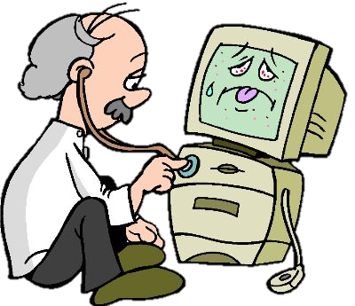
Tasks Performed to “Troubleshoot” the System
Examine problems or opportunities
Identify causes or impacting factors
Adjust the system to perform better

Slide 32
Monitoring and Correcting the Performance of Systems
Troubleshooting systems and improving performance involve your ability
to distinguish trends by observing the systems operating around you, and
to predict the impact of internal and external actions on these systems

Slide 33
Monitoring and Correcting the Performance of Systems
Continual improvement in the systems that you are a part of is the most desired outcome of system dynamics. Some people refer to this idea as the “daily pursuit of perfection.”
Your FFA chapter can operate smoothly or even improve its operations if you work with systems.

Slide 34
Improving and Designing Systems
One of the employability skills in high demand in today’s workplace is the ability to make suggestions for modifying existing systems, with the goal of quality improvement.

Slide 35
TQM – Total Quality Management
TQM is a concept that originated from the work of an industrial engineer named W. E. Deming, who identified a set of factors or “Points Toward Quality” that have been used to define the high-performance workplace of the future.

Slide 36
14 Points Toward Quality
Create constancy of purpose for improvement of product and service.
Management must be responsible for change.
Do not depend on mass inspection; build quality into the product.
Do not award contracts on the basis of price alone.
Improve constantly, and thus constantly decrease costs.
Institute training on the job.
Supervisors should aim to help people and gadgets do a better job.

Slide 37
14 Points Toward Quality
Drive out fear, so that everyone may work effectively.
Break down barriers between departments to make teams.
Eliminate slogans and targets for the workforce.
Eliminate numerical quotas for the workplace (and management).
Remove barriers that rob people of pride of workmanship.
Encourage education and self-improvement for everyone.
Take action to accomplish the transformation.

Slide 38
Developing New or Alternative Systems
Most people have the ability to point out when an organization is in trouble or something is wrong.
When you try to solve a key problem, you take charge of the solution. This gives you ownership of the problem-solving process!

Slide 39
Summary
Preferred qualities in potential employees identified by employers are:
Oral and written communication ability
Interpersonal skills
Teamwork skills
Analytical skills
Flexibility
Leadership skills
Job-specific skills proficiency
Computer / technology skills

Slide 40
Summary
Of the eight preferred skills, over half are related to systems and system dynamics. Those preferred skill areas are interpersonal skills, teamwork skills, analytical skills, flexibility, and leadership skills.
To prepare yourself for a successful career, develop and practice these system-related skills.

Slide 41
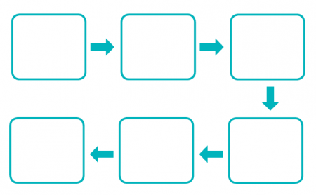
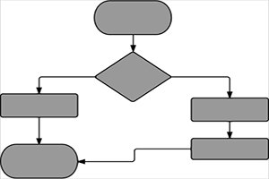
Activity
Create a flow chart defining systems of organization you see in your school district, campus, FFA chapter, or any other local organization

Slide 42
Today we…
Explained the purpose and benefits of systems in agriculture, food, and natural resources
Identified multiple examples over systems of organization
Created a flowchart defining the systems of organization

