Slide 1
You Better Reconcile

Slide 3
Reasons to Reconcile
  Know the amount of money in your account
  Verify the balance on your check register and statement are correct
  Aware of your account activity (wrong charges, duplicate charges, bank fees)
Notes:
While financial institutions strive for absolute accuracy in their record keeping, errors can still occur. There is always the possibility that you may have misposted a transaction in your recordkeeping. There are many reasons to go over your financial records. Reconciliation should be done on a regular basis so you are aware of how much money is in your account, match your records with the bank’s records and you are aware of your account’s activity.

Slide 4
Things Needed to Reconcile
  Check Register
  ATM Receipts
  Deposit Slips
  Current Bank Statement
  Calculator
  Pen/Pencil
Notes:
Any financial records can be, and should be, reconciled regularly to ensure accuracy. Discrepancies, found early in bank activity, are more easily corrected and reconciled.

Slide 5
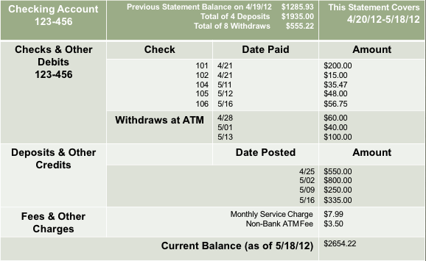
Understanding a Bank Statement
Notes:
When you are looking at your checking account bank statement, it will have the account number on it to inform you of the account the information is coming from.

Slide 6
Understanding a Bank Statement
Notes:
A previous statement balance will be on the bank statement signifying what the balance was at the time of the last statement. The total amount of deposits and withdraws for the current statement period will also appear on the bank statement.

Slide 7
Understanding a Bank Statement
Notes:
The statement posting date and statement dates will be at the top of the bank statement. Thiswill let you know what dates are covered during the statement period. Anything processed after the date will show up on the next statement.

Slide 8
Understanding a Bank Statement
Notes:
This will show all of the transactions you have made. Checks will be listed by check number and include the amount and the date it was paid. The date paid will not always be the same as the date the check was written because it may not get deposited and processed on the same day. Debit card transactions and ATM withdraws will also be listed.

Slide 9
Understanding a Bank Statement
Notes:
This section will show you the deposits, or amount of money put in to your account. It will also show you if there have been any credits to your account. You may have a credit if the bank accidently overcharges you or a business refunds you your money.

Slide 10
Understanding a Bank Statement
Notes:
As we discussed in the last lesson, some banks have service charges that will be taken out of your account each month. These fees and charges will also be listed on your bank statement.

Slide 11
Understanding a Bank Statement
Notes:
Lastly, the bank statement will show the current balance of the account as of the posting date of the monthly statement.

Slide 12
Steps in Reconciling an Account
  Step One: Compare your bank statement and check registry to determine which transactions have been processed.
Notes:
Step one is to compare the bank statement with your personal check registry to see which transactions have been processed. You can highlight the transaction, or check the box next to the transaction, signaling it has been processed.

Slide 13
Steps in Reconciling an Account
  Step Two: Add any deposits listed in your check registry, but not on your statement.
Notes:
The next step in reconciliation is to add any deposits in the check registry. This may not be in the bank statement yet, if it happened after the posting date of the monthly bank statement.

Slide 14
Steps in Reconciling an Account
Step Three: Subtract any outstanding check/debit purchases.
Notes:
After that, subtract any outstanding checks or debits. An outstanding amount is one that has been written, but not yet processed by the bank.

Slide 15
Steps in Reconciling an Account
Step Four: Compare balance with your check registry
Notes:
Next, compare your balance with the check registry. Each balance should be equal to one another.

Slide 16
Steps in Reconciling an Account
Step Five: Adjust balance to include any service charges or other fees.
Notes:
Add service charges or other fees to the balance that may not be present.
After step five, have students take out the handout, “How to Reconcile a Bank Account” and reconcile the account as a class using the bank statement on the next slide.

Slide 17
Steps in Reconciling an Account
  Step One: Compare your bank statement and check registry to determine which transactions have been processed.
  Step Two: Add any deposits listed in your check registry, but not on your statement.
  Step Three: Subtract any outstanding check/debit purchases.
  Step Four: Compare balance with your check registry.
  Step Five: Adjust balance to include any service charges or other fees.
Notes:
Review all steps as students complete the handout together.

Slide 18
Reconciling an Account
Notes:
Use this bank statement to complete the handout, “How to Reconcile a Bank Account” as a class. First, students will determine if there are any outstanding transactions. Lead students through the handout.

Slide 19
References/Resources
  Images:
    Microsoft Office Clip Art: Used with permission from Microsoft
  Websites:
    Financial Literacy Now
    http://www.financiallitnow.org/index.shtml
    Practical Money Skills
    https://www.practicalmoneyskills.com
    Credit Union National Association
    http://anytime.cuna.org/15608/index.php
    http://anytime.cuna.org/15111/checking/checkbook_reconciling.htm
  YouTube
    How to Balance a Checkbook : How to Reconcile a Checkbook
    Running Time: (4:03) Release Date: 10/18/2007
    http://www.youtube.com/watch?v=0eciD5AhRUI

