Slide 1
You Said What?
Communication Skills
Notes:
In order to be a good communicator, we need to become aware of how messages are sent and received.

Slide 3
What is communication?
  The process of sending and receiving information by gestures, talk, or writing for a response or action
  It is a learned skill
  Includes both verbal and non-verbal communication

Slide 4


Two Kinds of Messages
  Historical Information – happened in the past
  Action-Required Information – expect something to happen because of the message
Notes:
Generally there are 2 types of messages. Historical information shares information that happened in the past that may be relevant to the message being sent.
Action required information tells that some information needs to be acted on immediately or in the future.

Slide 5
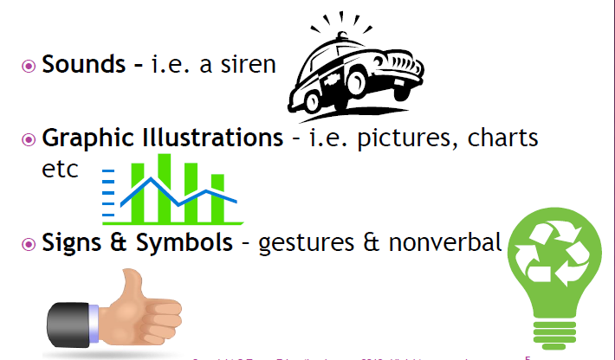
Message Forms
  Words – verbal or written
  Sounds – i.e. a siren
  Graphic Illustrations – i.e. pictures, charts etc.
  Signs & Symbols – gestures & nonverbal
Notes:
We communicate several ways. We use words, either written or verbal. To be able to successfully communicate a message, we need to be able to speak and write clearly and concisely so the receiver(s) understands.
Sounds also send a message. Sirens tell us that someone is in trouble – they are either hurt or have done something they shouldn’t have.
Graphic illustrations should be able to send a message without many words. A chart can tell someone if something is improving or declining. Pictures can share the good time had at a vacation or an event.
Signs and symbols also communicate things without words. A traffic light tells drivers to stop, go, or slow down depending on the color of the light. We know if a package is recyclable by looking for the recycle symbol. And, we can tell if we have done a good job if someone gives us a thumbs up, high five, or fist pump.

Slide 6
Barriers/ Obstacles to Good Communication
  Language Differences – accents, dialects
  Semantics – what words mean
  Jargon – buzz words, technical language, slang
  Tone of message – the way it is said
Notes:
Even within the same country, there may be language differences from state to state or region to region. Many areas have different accents that may make communicating difficult. In one area a Coke Cola™ may be called soda, and in another region it may be a pop. Think of regions of the United States, how many different accents can you think of?
Semantics means what a word means. Some words are spelled the same but have different meanings. Take mouse for instant, it can be a rodent or a computer device.
Jargon can be related to certain industries or even different generations. Cool for grandma might mean to not be hot, but cool to a teen might mean awesome.
The way we say words or the tone of the message also affect how it is received. If a teacher told you good job, but they stated it in a loud upset voice while they were scowling would the message be received well?

Slide 7
Barriers/ Obstacles to Good Communication
  Clarity – make sure the message is clear
  Assumptions – understand what audience knows before you send the message
  Cultural Differences – consider any cultural differences.
  Prejudices & Biases – negative ideas that may affect the message
Notes:
Sometimes when we talk we know exactly what we want to say, but our mouth moves faster than our brain. If you want someone to understand exactly what you are saying, be very clear in your delivery.
Assumptions falsely lead you to believe something that may not be true.
We are a global generation. In any given day, we may encounter someone from a different culture, or someone that practices a different religion. If you were to decide to go out to eat with such a person you may want to find out what food they are able to eat and what their main meal of the day is. If you go out to dinner with someone from India you may not want to go to Texas Roadhouse.
Preconceived ideas or prejudices or biases can affect the way a message is received. A couple of biases could include: “teenagers are lazy,” or “older people are computer illiterate.” If you have that prejudice or bias, you may not want to try to teach grandma or grandpa how to text!

Slide 8
Barriers/ Obstacles to Good Communication
  Noise – interferes with clear reception
  Nonverbal Boundaries – personal space
  Gestures – non-verbal communication
  Other distractions – personal life, mood, etc.
Notes:
What types of noises can make hearing a message difficult? Traffic, music, talking by others, dogs barking. If you are trying to communicate a message, try talking in a quiet area.
We all have our personal space; an area that we are not that comfortable in when other people break that boundary. In fact, unless they have a close relationship with us, we may feel threatened if that boundary is broken.
We are all too familiar with non-verbal communication. As one drives down the road, they may experience various gestures by other drivers! We may know when our parents are mad just by the way they stand or the look on their face. What can gestures tell you?
There are many other distractions that can affect communication. Sometimes just our mood interferes. If we are in a really bad mood, we may not be very accepting of the messages sent our way. If we are having struggles in our personal life, it may be difficult to focus on what others are saying.

Slide 9
How to Prevent Barriers to Communication
  Observe the audience
  Decide best way to get the message out
  Make sure message was successfully received
Notes:
Now that we are aware of the barriers to good communication, how can they be prevented?
When you are talking, know who your audience is. Who are you talking to?
Decide the best way to get the message out. Should it be verbal, written, in a group, or private?
Finally, determine if the message was successfully received. Ask the person if they understood what you are saying, or if you are the receiver, repeat what was said just to clarify.

Slide 10
  Ratatouille - Film Clip: "It's Very Hard to Explain“
  Linguini cooks up a storm...with the secret help of Remy
  http://youtu.be/TlfomfB2BNs
Notes:
Clip from the movie Ratatouille. Show the scene where the linguini and Remy (the rat) try to figure a way to communicate. Discuss audience observations.

Slide 11
References and Resources
  Textbook:
    National Restaurant Association, Foundations of Restaurant Management & Culinary Arts, Boston, Pearson Education Inc., ©2011, Chapter 7, pgs. 413 – 459.
  YouTube:
    RATATOUILLE - FILM CLIP: "IT'S VERY HARD TO EXPLAIN“
    Linguini cooks up a storm...with the secret help of Remy http://youtu.be/TlfomfB2BNs
  Websites:
    About.com Family Crafts
    A valuable resource for content that helps people to solve the large and small needs of everyday life.
    http://familycrafts.about.com/cs/coloringpages/l/blboxtemplate.htm
    Communication Barriers – Reasons for Communication Breakdown, Project Management Institute, 3/19/ 2012, http://www.managementstudyguide.com/communication_barriers.htm
    Your Academic Encyclopedia, Note Desk, Word Press, 3/19/2012, http://notesdesk.com/notes/business-communications/types-of-communication/

